Slide 1
Agents in OBIEE
September 22, 2016

Slide 2
Overview of Agents
Agents are automated tasks that are created in order to deliver queries, dashboards or alerts to one or more users.
These queries can be set to be delivered to users only one time, on demand or on a regular schedule depending on organizational needs.
Queries can be delivered to user’s home page, dashboard page, email account or mobile device.
On Dashboard pages agents appear as alerts.
Agents can be set to deliver only when a certain condition is met.

Slide 3
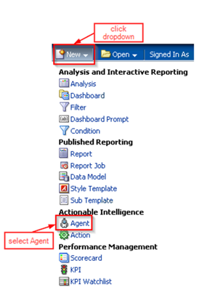
Creating an agent
Go to New object icon in the global header and click the Agent icon under the actionable intelligence section.

Slide 4
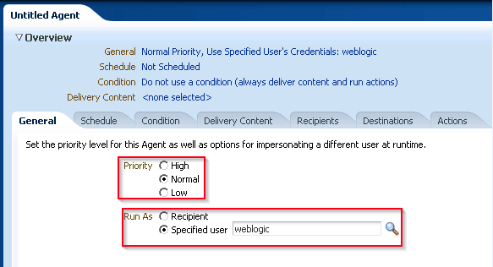
Creating an agent (cont.)
2. - In the General tab, set priority Level (high, low or normal) eg. high priority can
be delivered to mobile devices and low priority to email.
- specify whether it runs using the credentials of the agent author or as a
specific user’s credentials and data visibility (usually the superuser or agent
author).

Slide 5
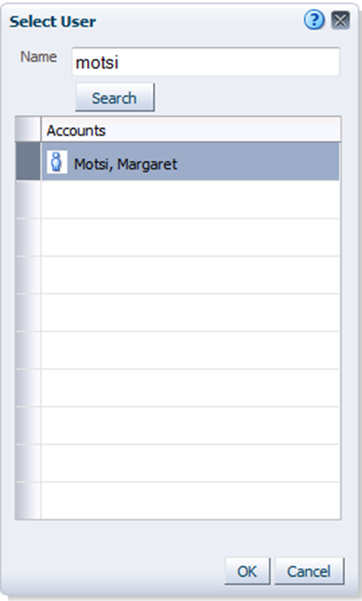
Creating an agent (cont.)
You can search for a specific user/group

Slide 6
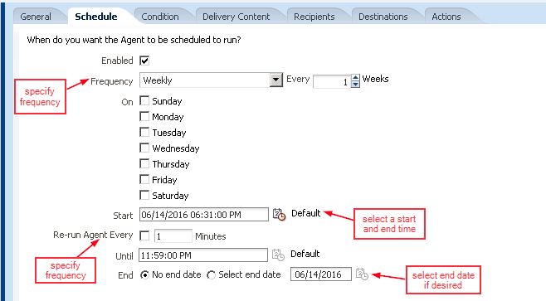
Creating an agent (cont.)
3. In the schedule tab, set the schedule and frequency to run the agent. Make sure that enabled is checked.

Slide 7
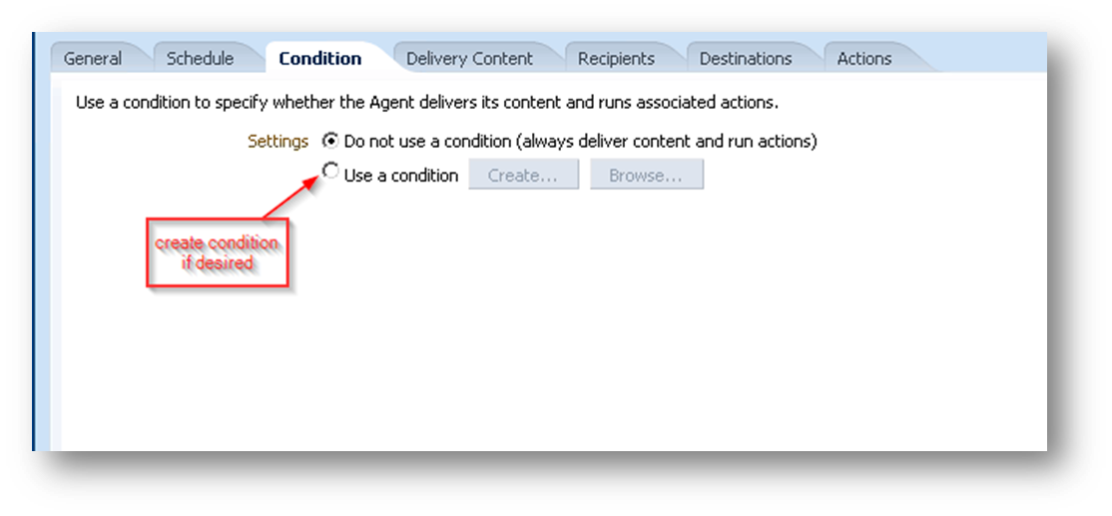
Creating an agent (cont.)
4. In the Condition tab you can leave as default for now. We will discuss conditions later in this session.

Slide 8
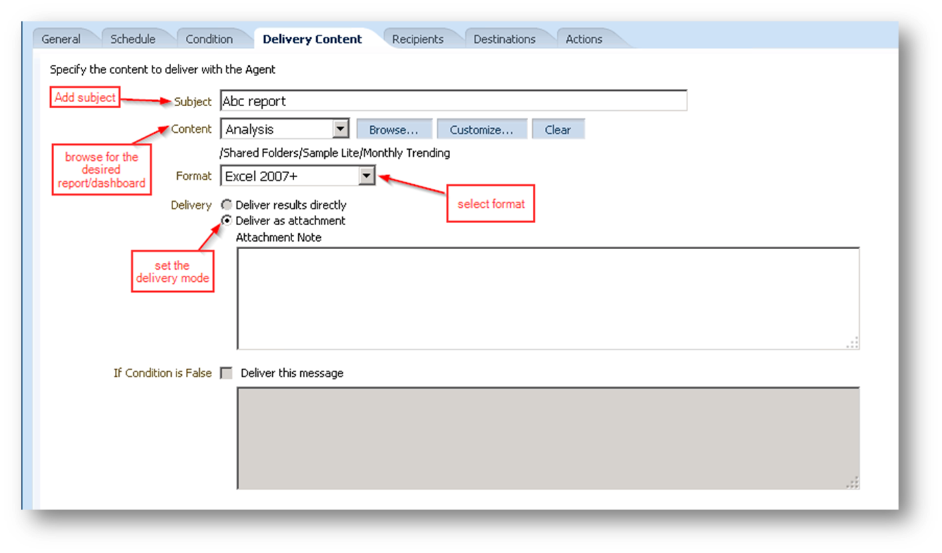
Creating an agent (cont.)
5. In the Delivery content tab enter the subject for the delivery message, select the query/dashboard to be delivered and the mode and format it is to be delivered.

Slide 9
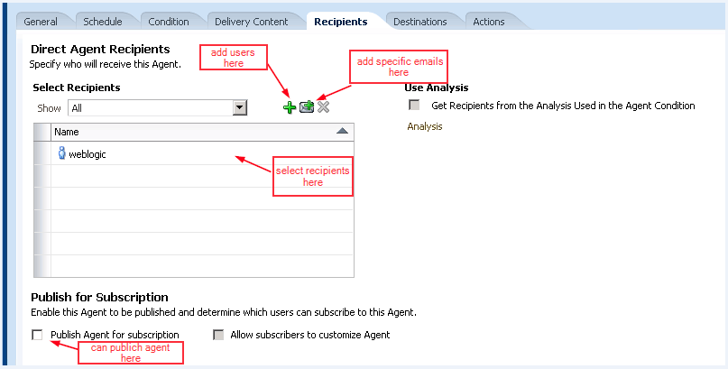
Creating an agent (cont.)
6. In Recipients tab, enter the recipient/s (can be individual user, group or by application role).

Slide 10
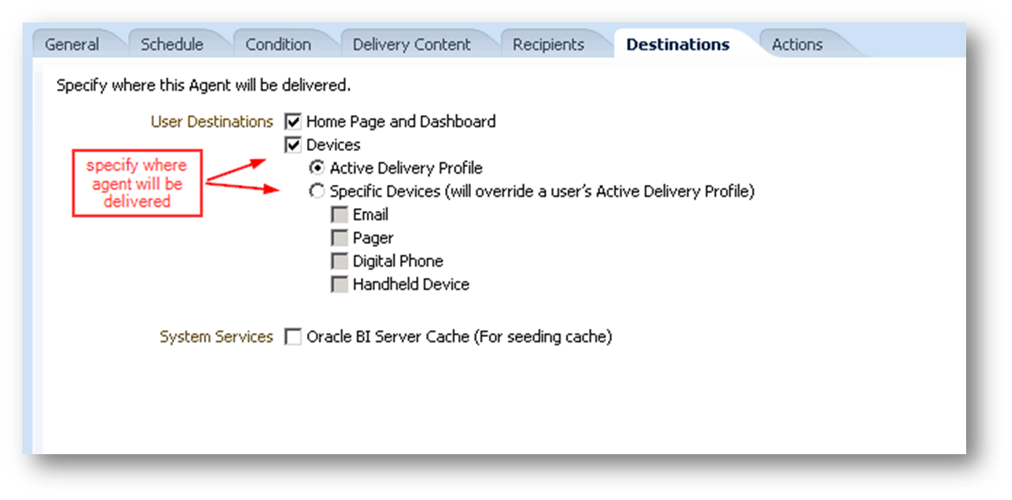
Creating an agent (cont.)
7. In the Destinations tab specify where you want the query to be delivered, Home page and Dashboard as an alert or to a device.

Slide 11
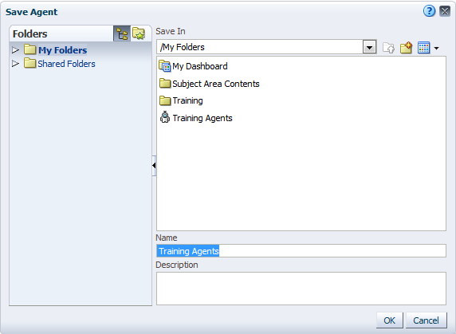
Creating an agent (cont.)
8. Save the Agent in a folder

Slide 12
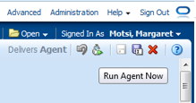
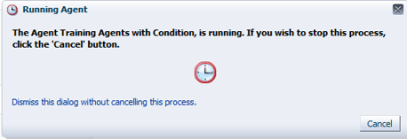
Creating an agent (cont.)
9. You can test the agent by manually running it using the Run Agent Now button.

Slide 13
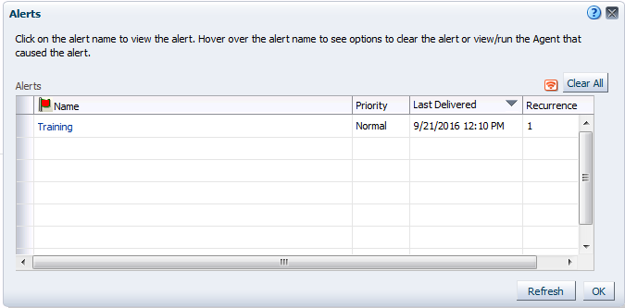
Creating an agent (cont.)
10. After the Agent runs you will see the alert listed on the home page or global header.
If you click on the alert you will see the list of agents

Slide 14
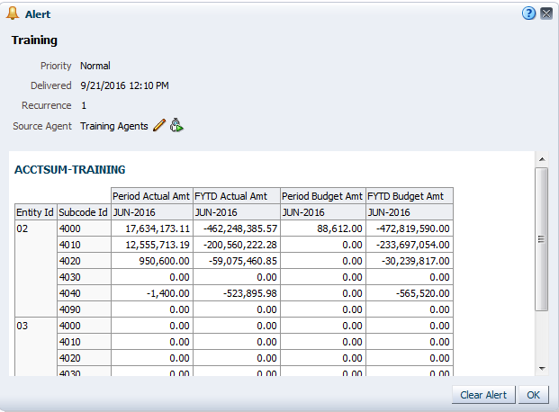
Creating an agent (cont.)
11. Click on the agent and it will pull up the query.

Slide 15
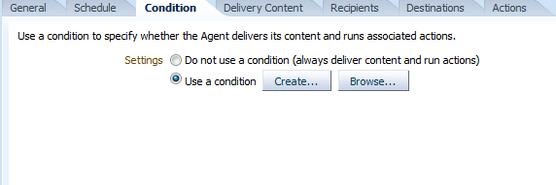
Adding a condition on agents
You can also set an agent to only deliver the query to users when a certain condition like an “exception” has been met.
Prior to this you already created a query with the desired condition. In the Condition tab you can select “use a condition” click the create button to
create the condition

Slide 16
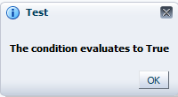
Adding a condition on agents (cont.)
2. - After clicking the create button, Navigate to the query with condition.
- Specify in what circumstance the condition should be applied. (is true if row
count is greater than X number of rows eg. greater than 1 row)
- Test the condition.

Slide 17
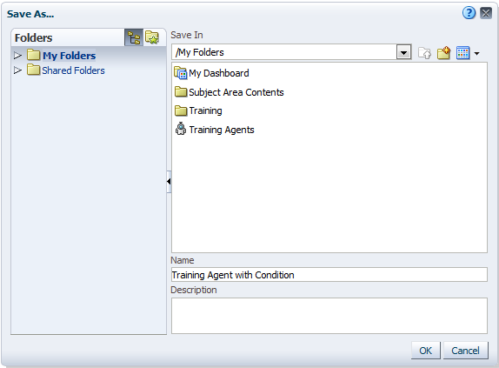
Adding a condition on agents (cont.)
3. You can save the condition to Catalog

Slide 18
Adding a condition on agents (cont.)
4. You can test the agent by manually running it.

Slide 19
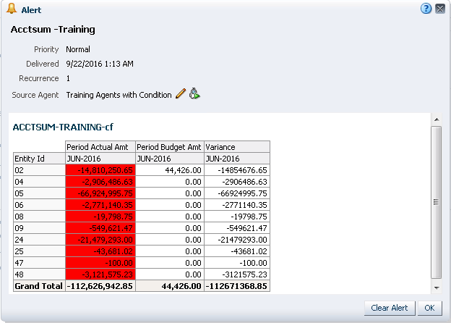
Adding a condition on agents (cont.)
Even if its on a set schedule the agent will only run if the condition has been met.

Slide 20
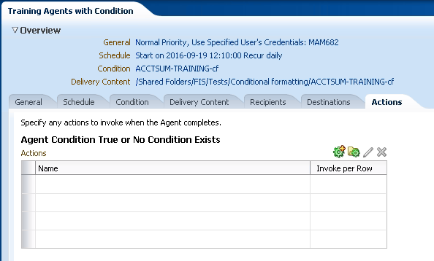
Chaining Agents
Agents can be set up to execute in succession, where if a condition is met then it triggers another agent to run and deliver say a more detailed or more specific query.
1. To achieve this go to edit an already existing agent and click on the Actions tab

Slide 21
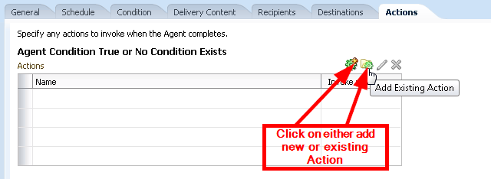
Chaining Agents (cont.)
2. In the “Agent Condition True Or No Condition Exists” section, either click the Add New Action button to create a new agent, or click the Add Existing Action button to select an agent from the catalog.

Slide 22
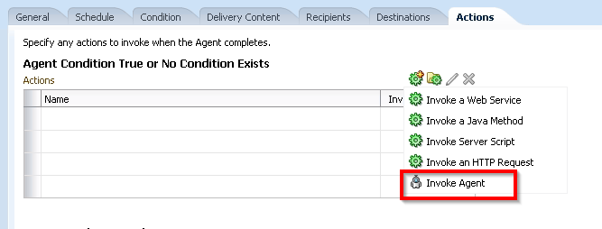
Chaining Agents (cont.)
3. For this example we will choose the Add New Action option and select invoke Agent for the action to call another agent.

Slide 23
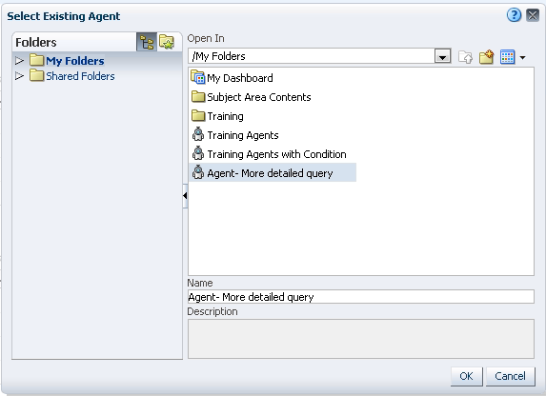
Chaining Agents (cont.)
4. Select the existing Agent.

Slide 24
Chaining Agents (cont.)
5. Specify recipients
6. Click OK, save and run the query to test.

Slide 25
Chaining Agents (cont.)
7. Notice when the agent runs, if the condition is met it will run the other agent that
delivers the more detailed query.
So you get an alert when there is an exception and you can look at both the summary and more detailed queries from the alerts without having to dig through mutiple queries.

Slide 26
Demo

Slide 27
Q&A

