Slide 1
Direct to Student
End to End Experience

Slide 2
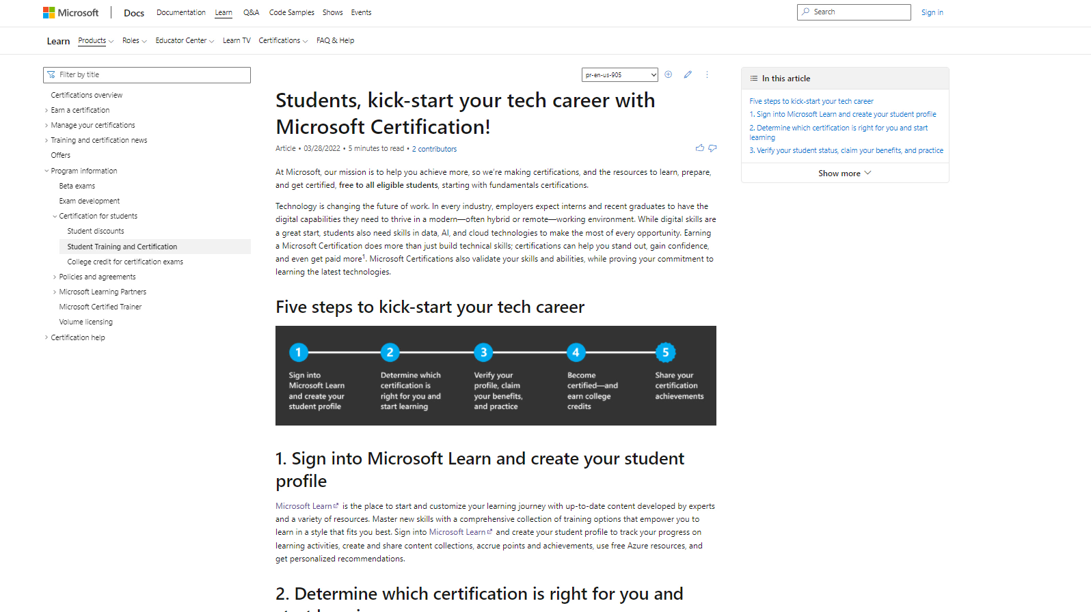

Slide 3
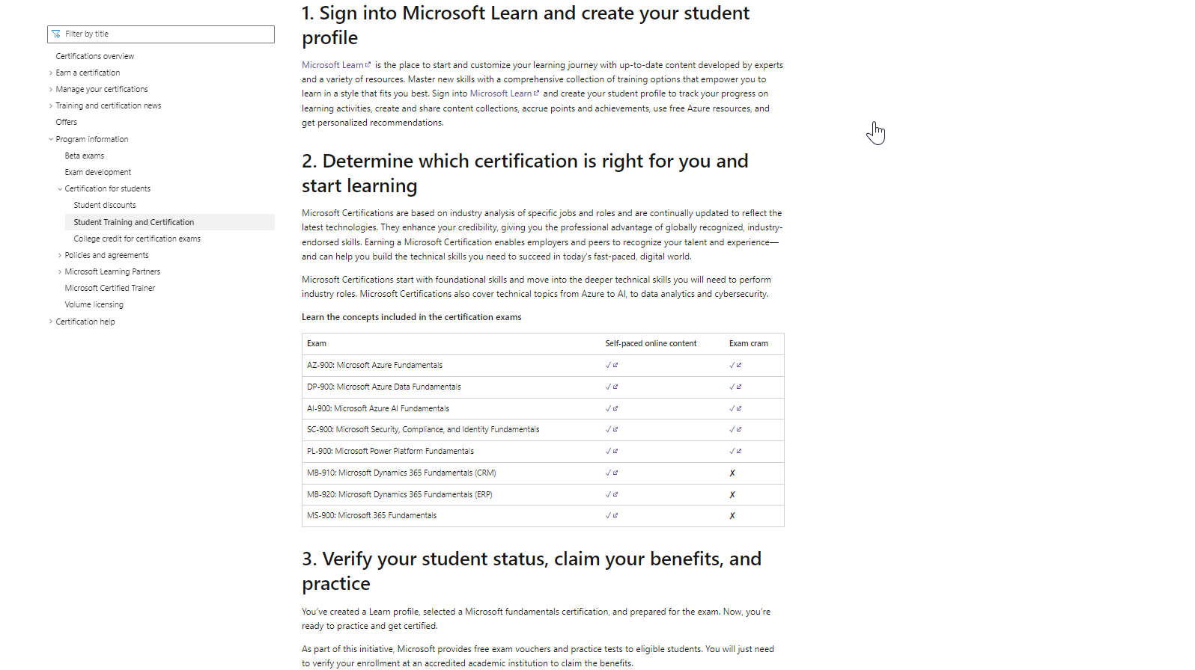

Slide 4
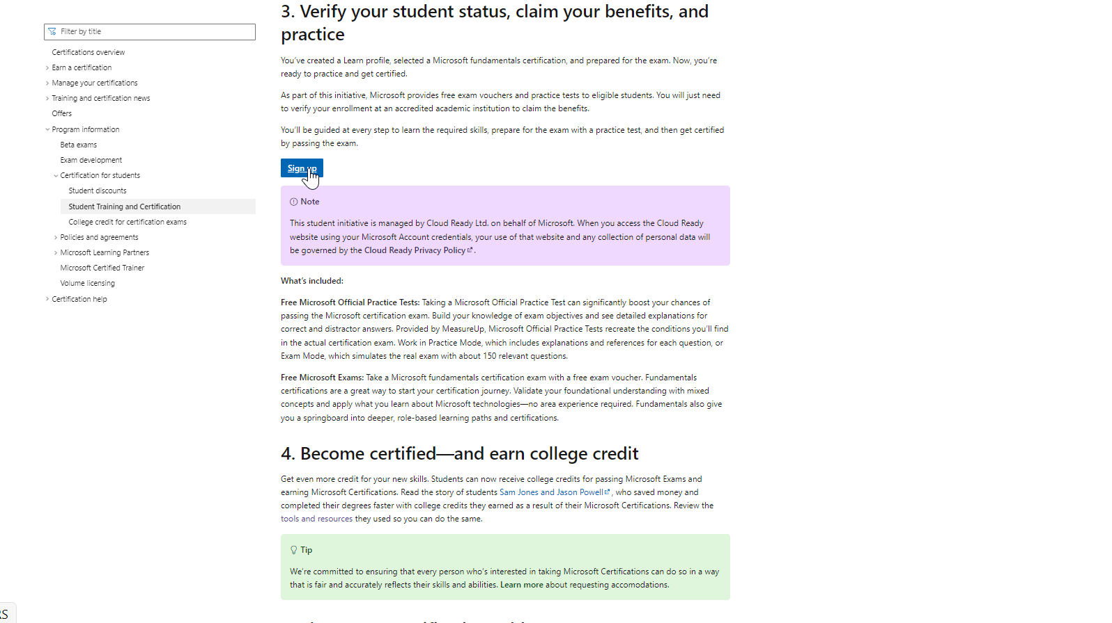

Slide 5
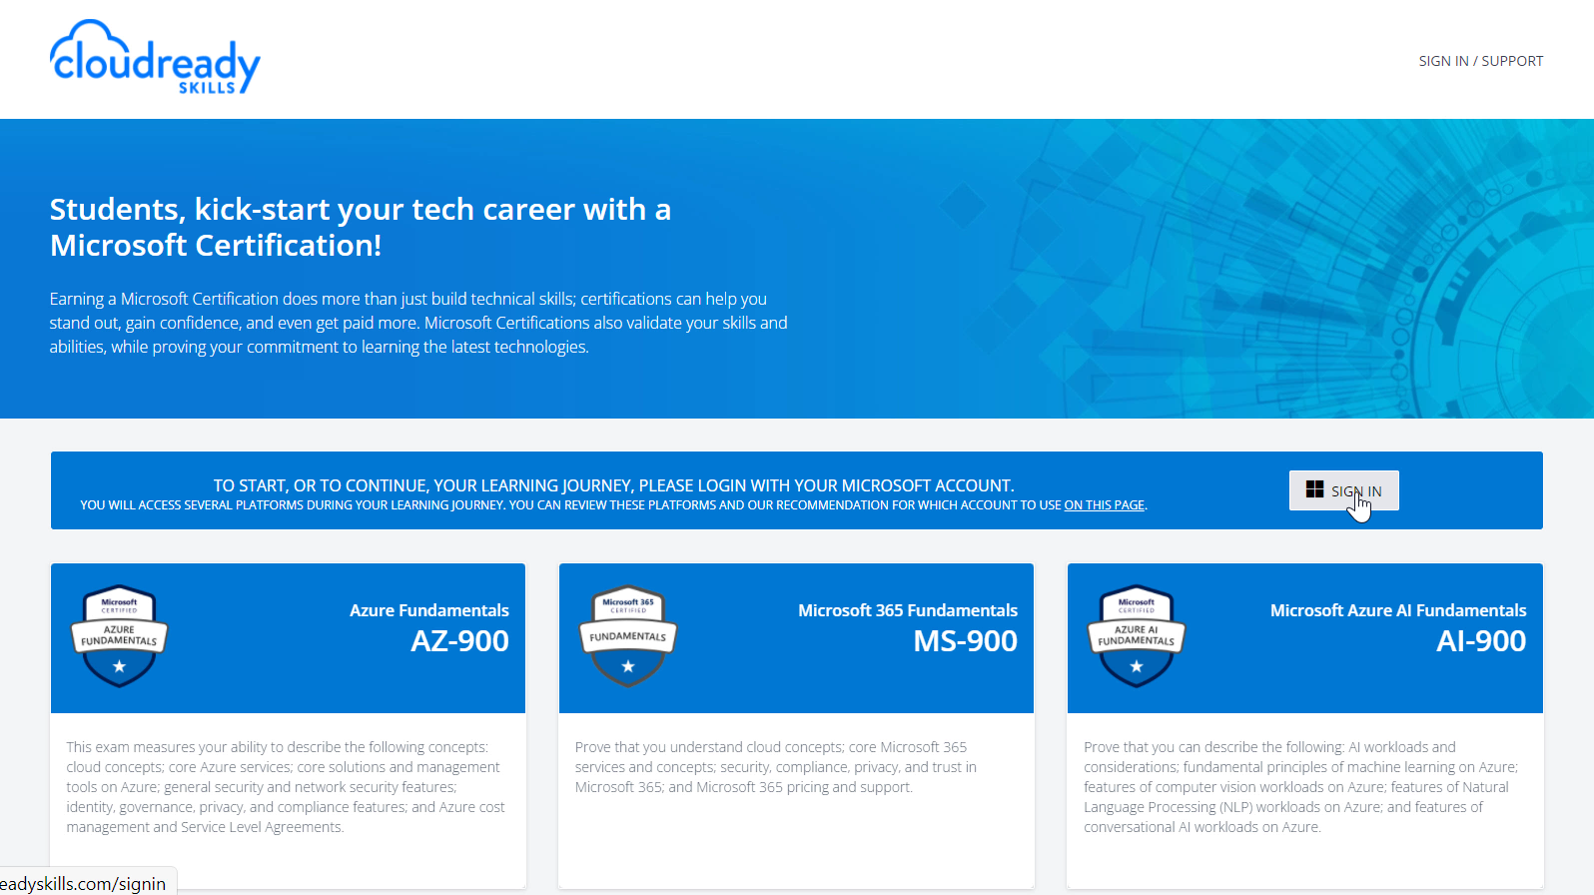
Cloud Ready Skills is our partner who manages the distribution of practice tests and exam vouchers

Slide 6
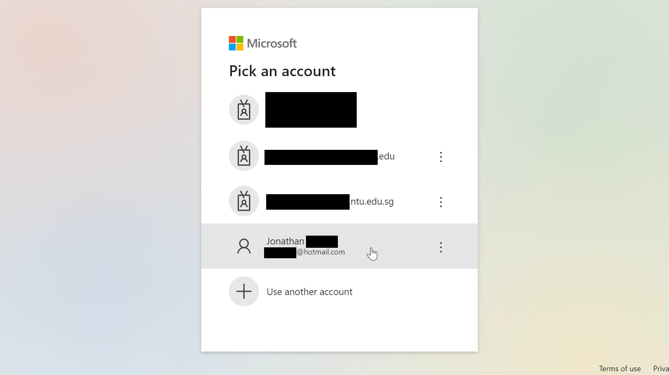
We recommend signing-in using a personal Microsoft account such as @outlook.com

Slide 7
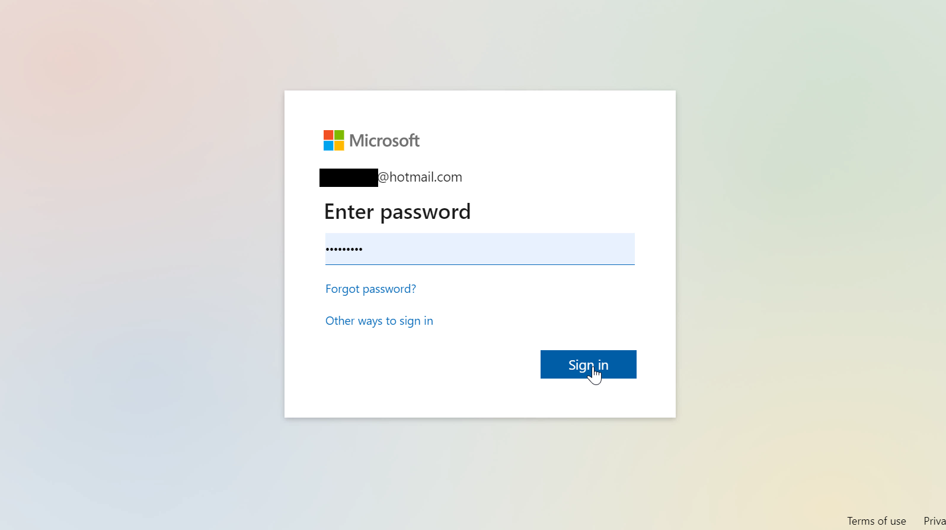

Slide 8
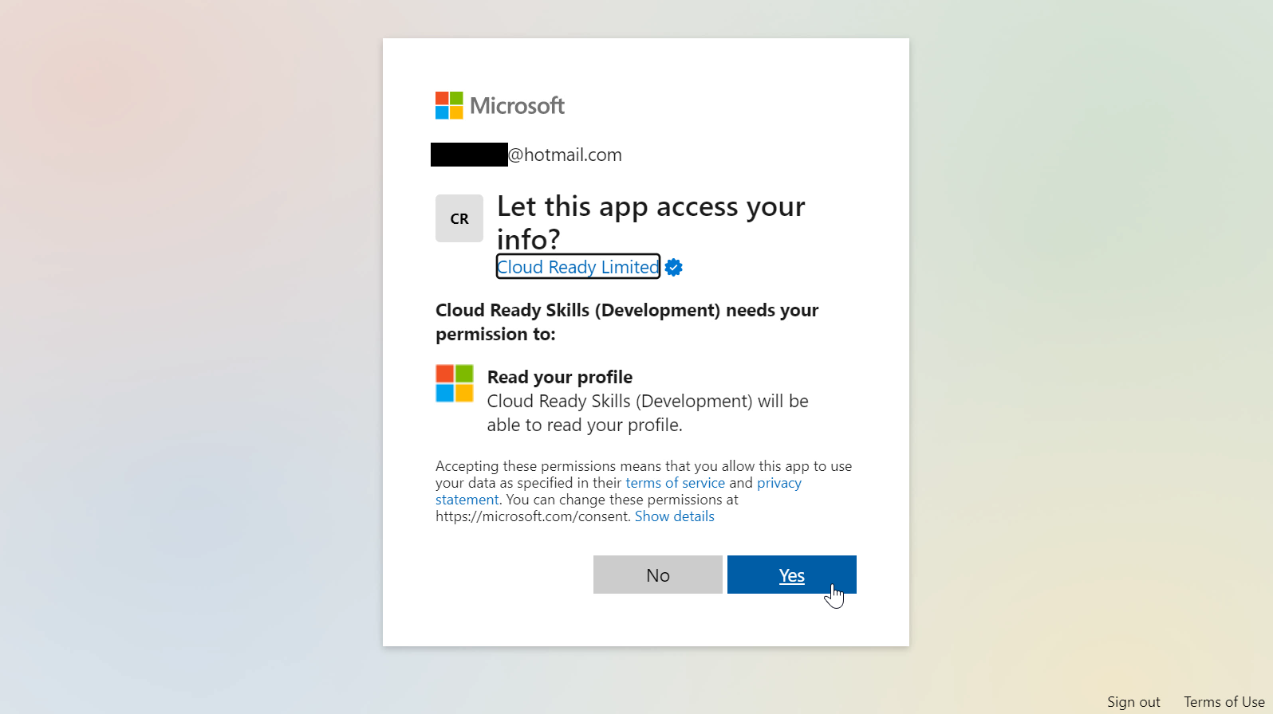

Slide 9
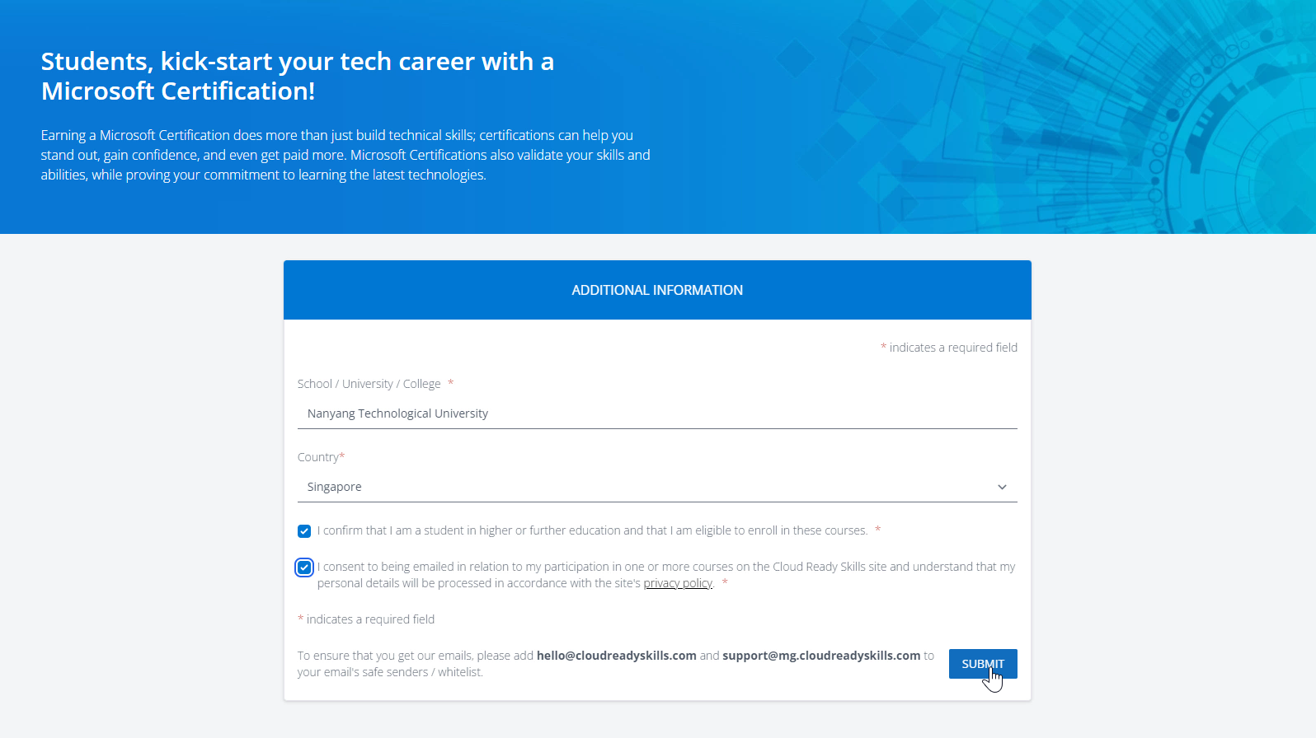
Enter your school information (University of Pittsburgh, USA).

Slide 10
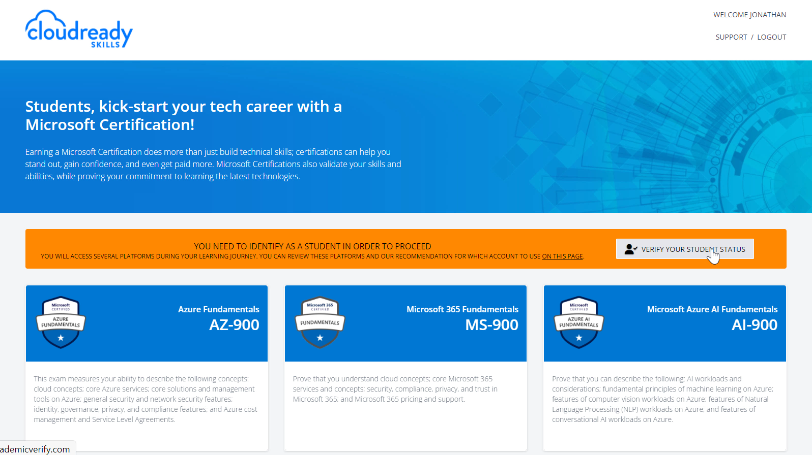
Now, we ask that you verify your academic status

Slide 11
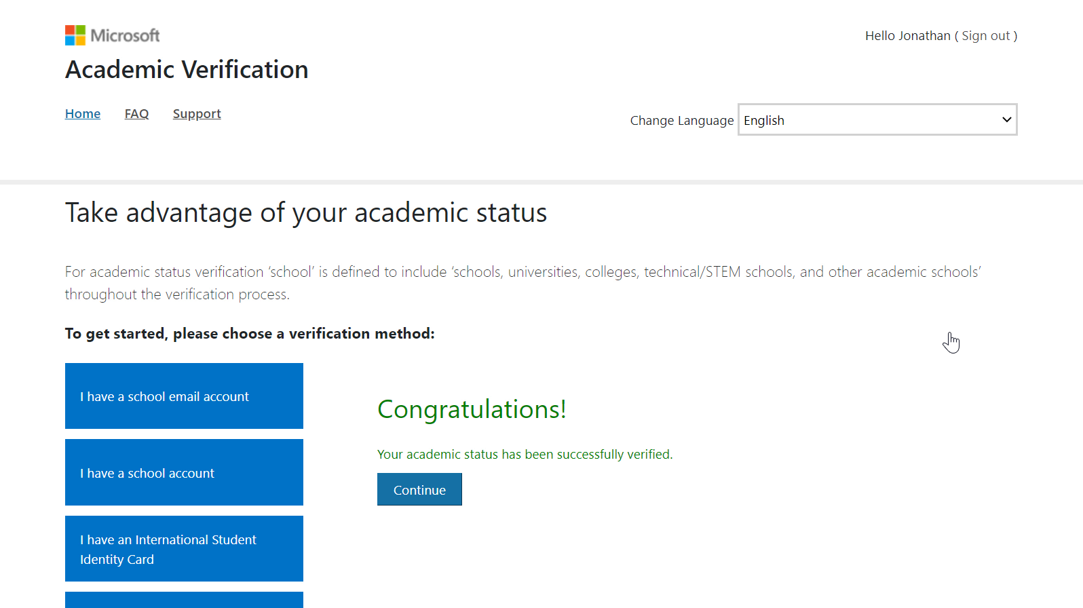

Slide 12
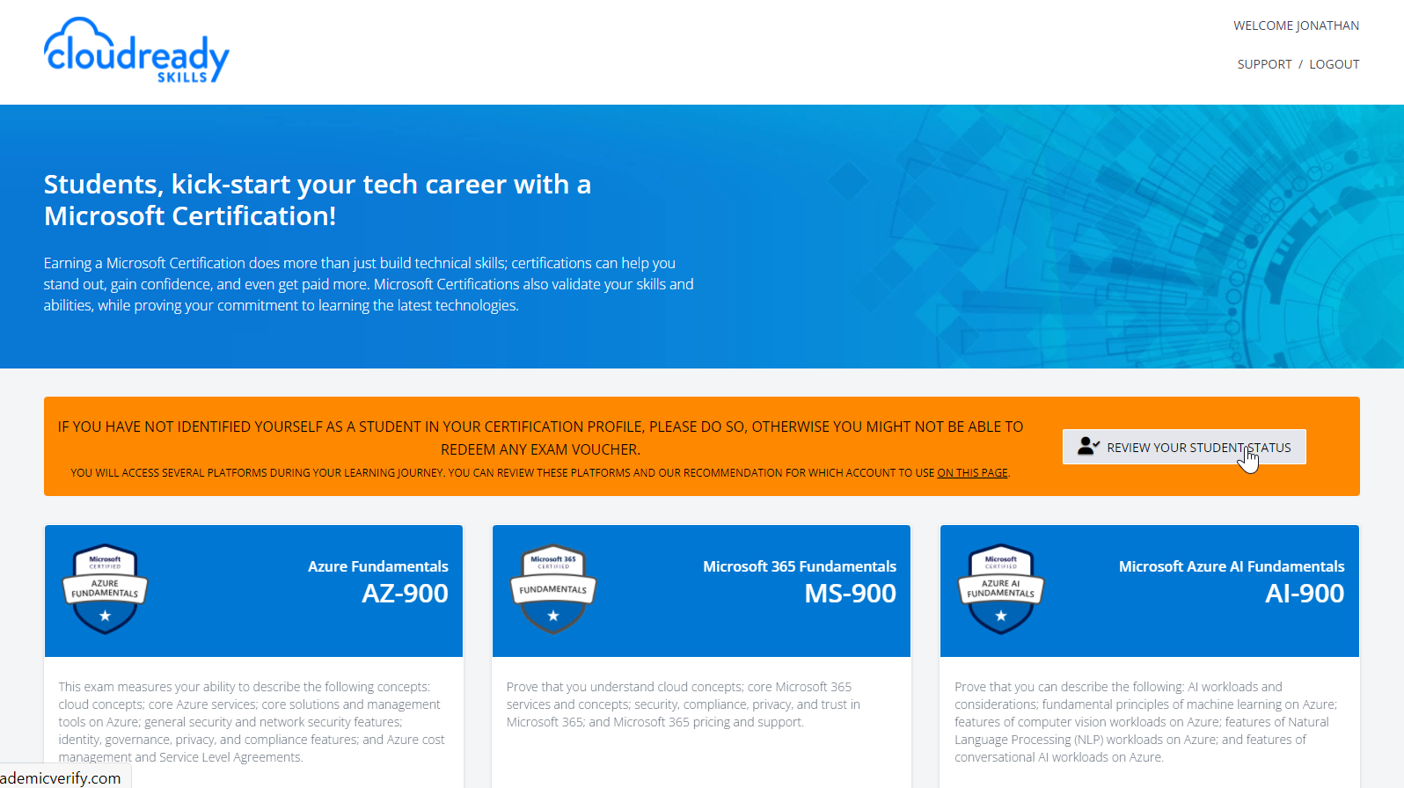

Slide 13
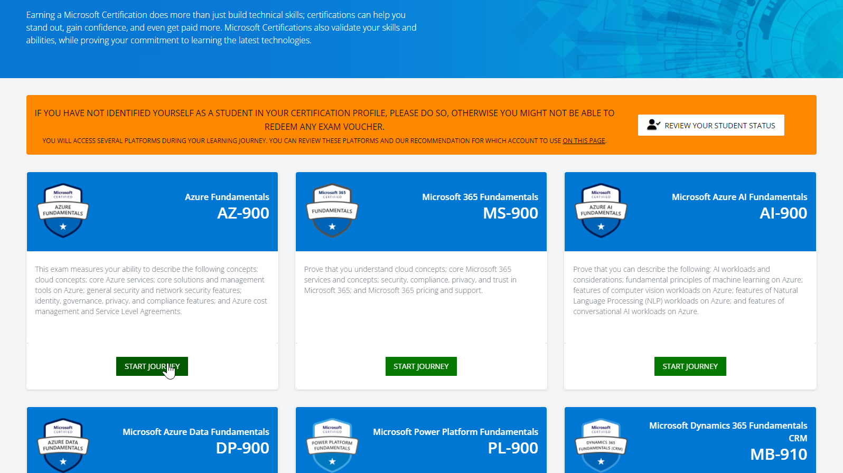
You can proceed to select any of the available Microsoft Fundamentals

Slide 14
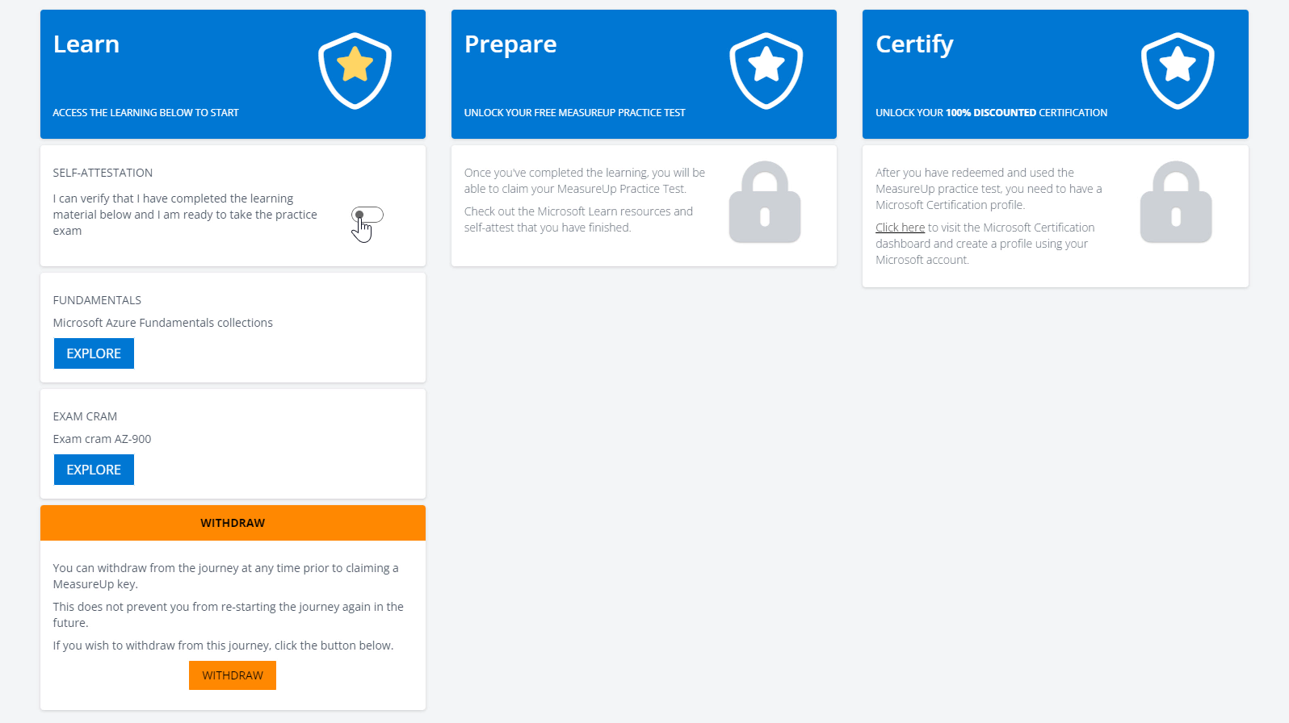
You are presented with the Learn, Prepare, Certify screen.
At any time you can self-attest that you completed the learning stage.

Slide 15
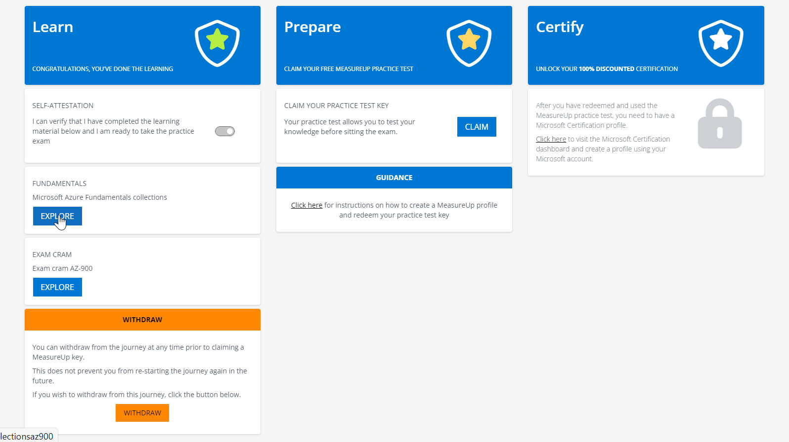
You can review the learning
materials on Learn

Slide 16
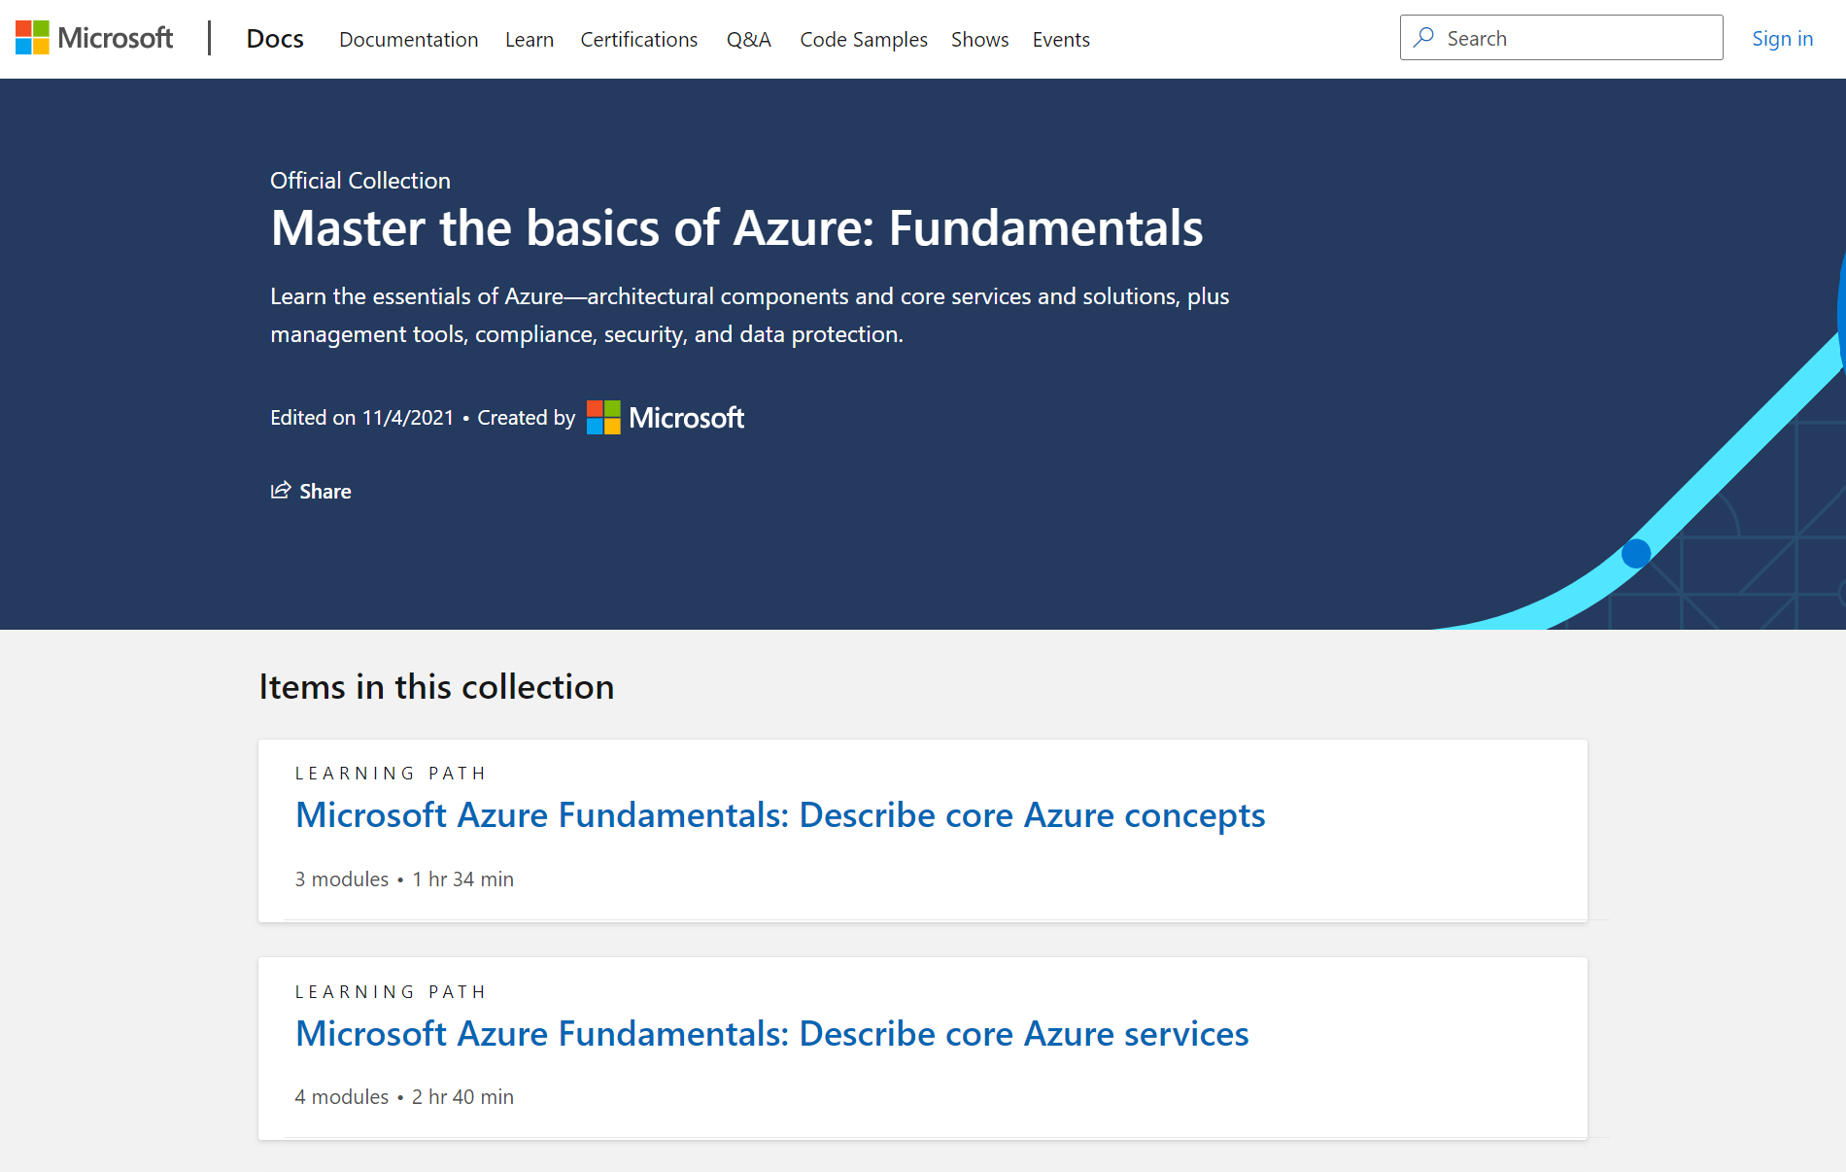
This is an example of a collection of Learning Path on Microsoft Learn. You can sign into Microsoft Learn to save your learning progress.

Slide 17
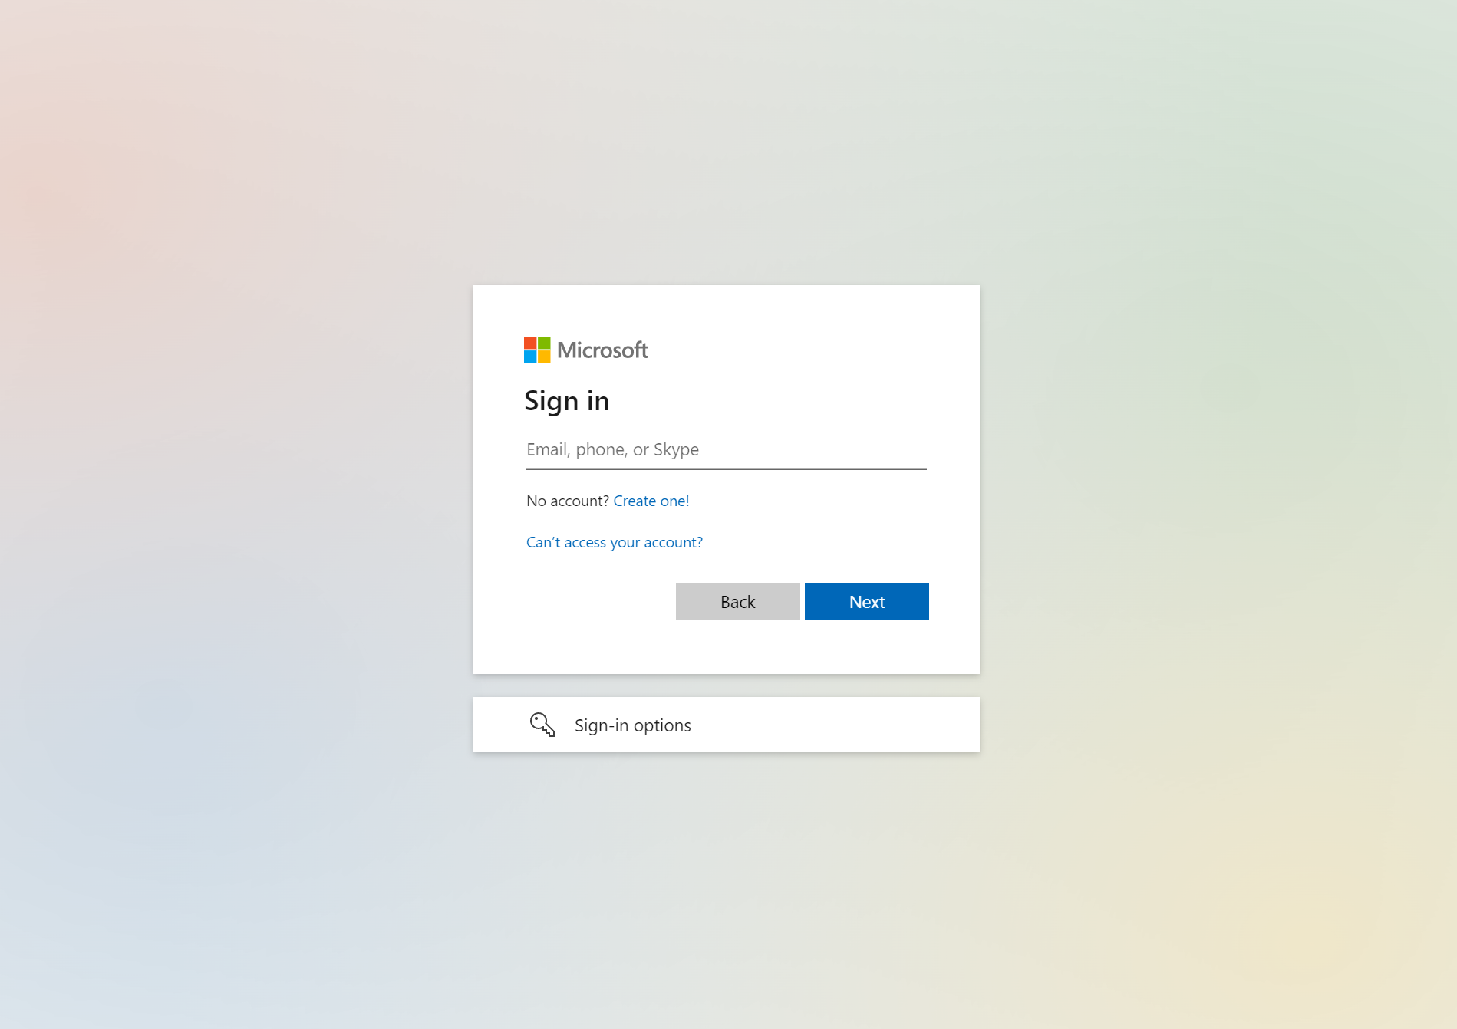
You can sign in to Microsoft Learn using your personal Microsoft account, or you school account

Slide 18
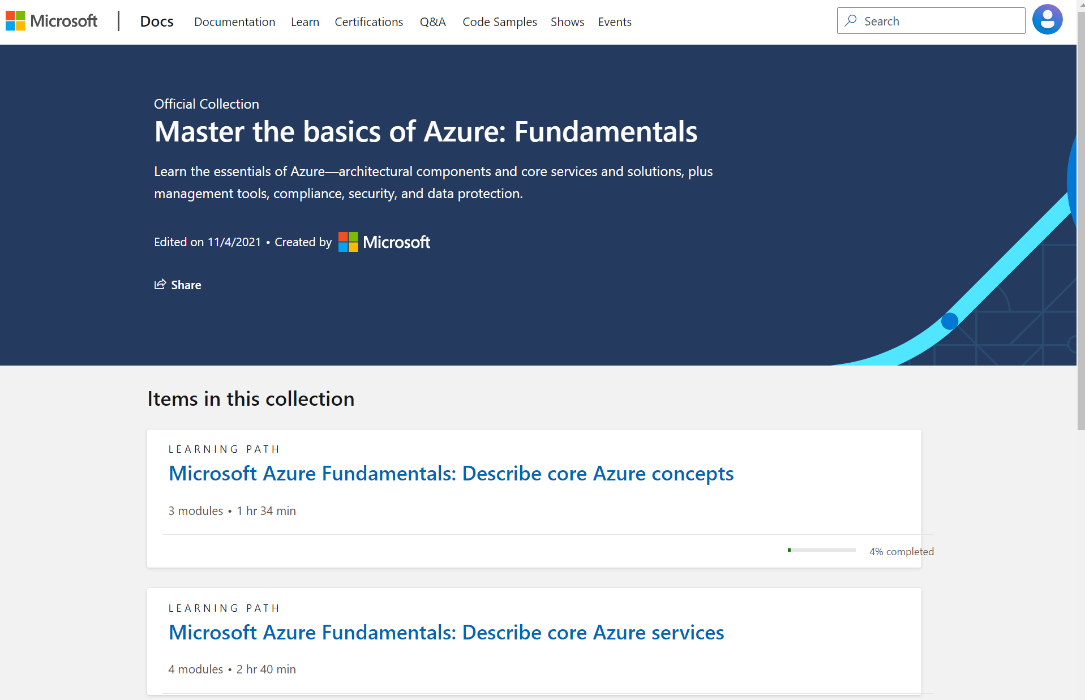
When you are signed in, your learning progress is saved

Slide 19
Back at the Cloud Ready site, you can also review an Exam cram (for those exam which has it)

Slide 20
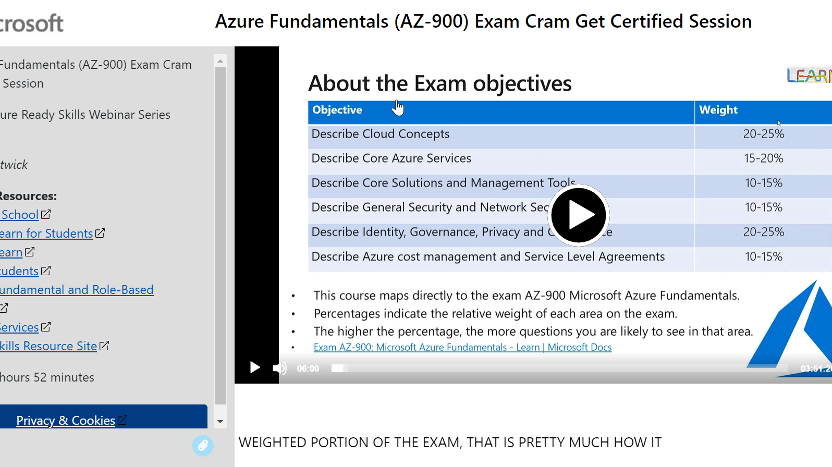
Exam cram is a recording of exam preparation session

Slide 21
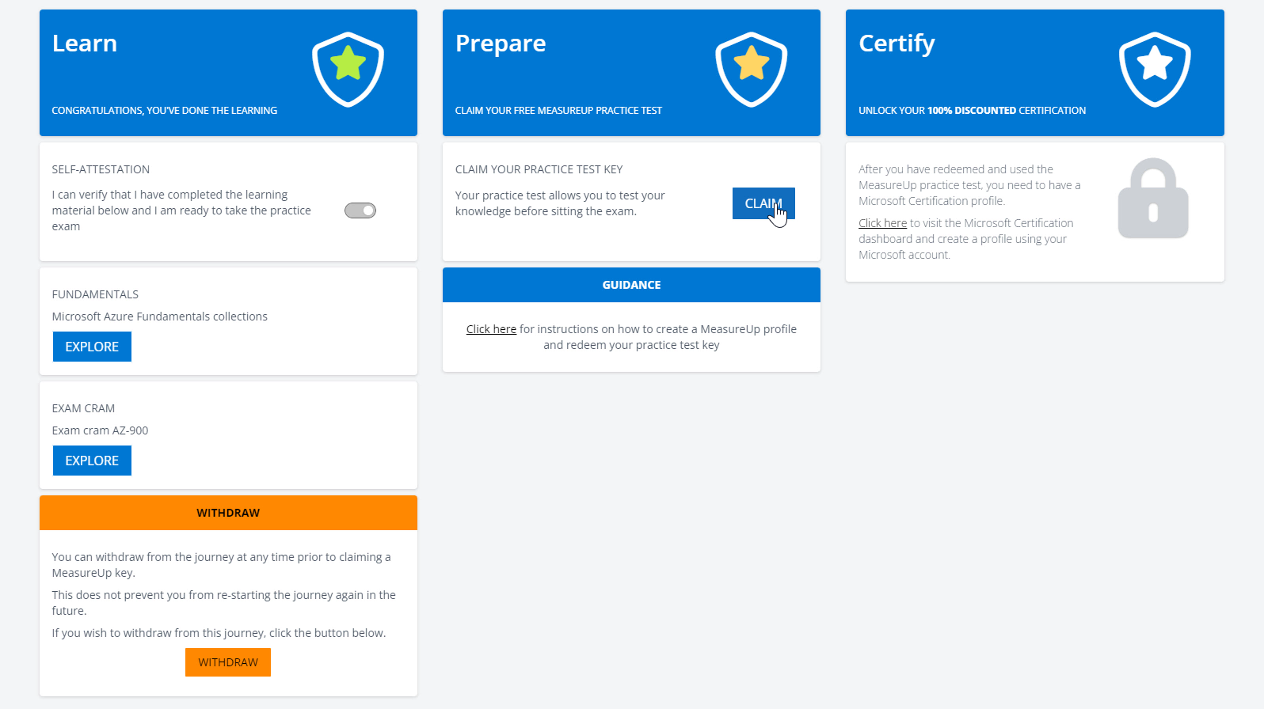
Once you self-attest that you completed learning stage, you can claim a Free Practice Test key

Slide 22
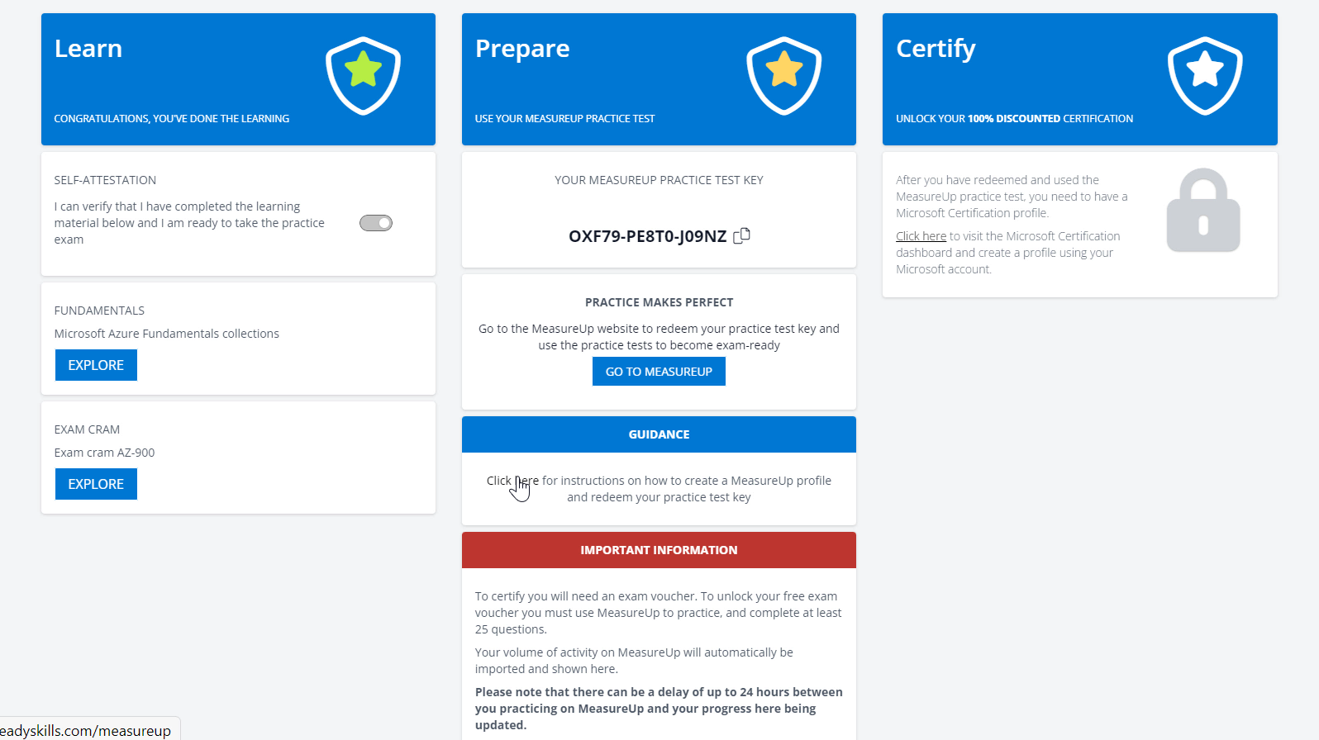
You can learn more about Practice Test

Slide 23
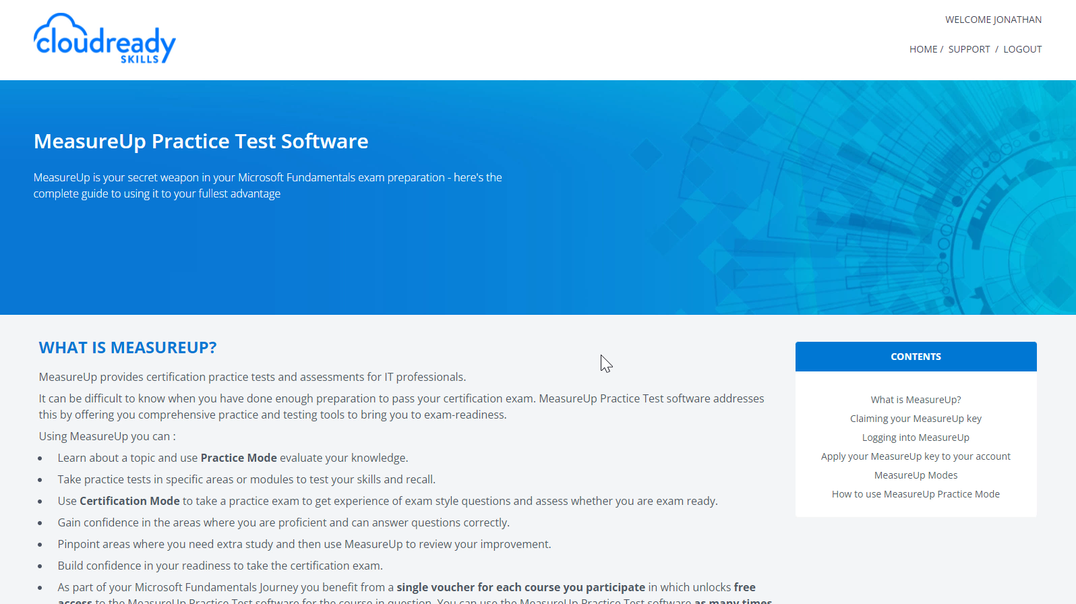
Measure Up is our partner who provides the Practice Test experience

Slide 24
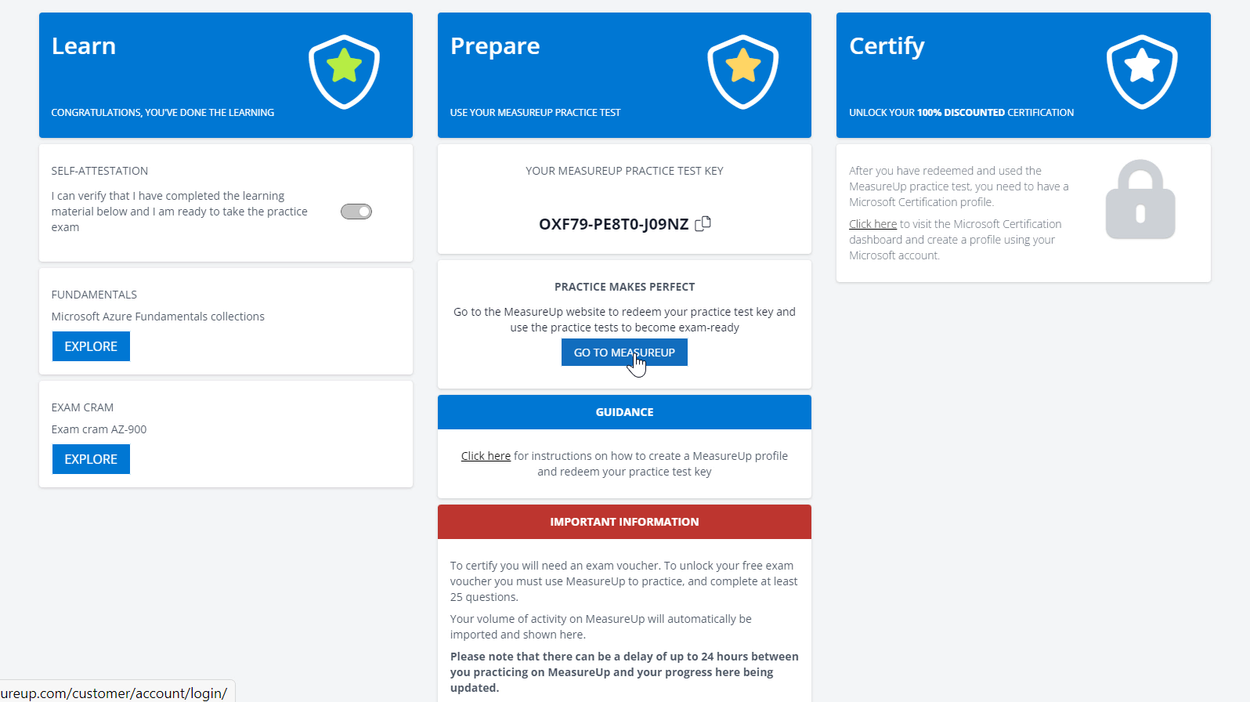
You can redeem this Practice Test key on Measure Up site

Slide 25
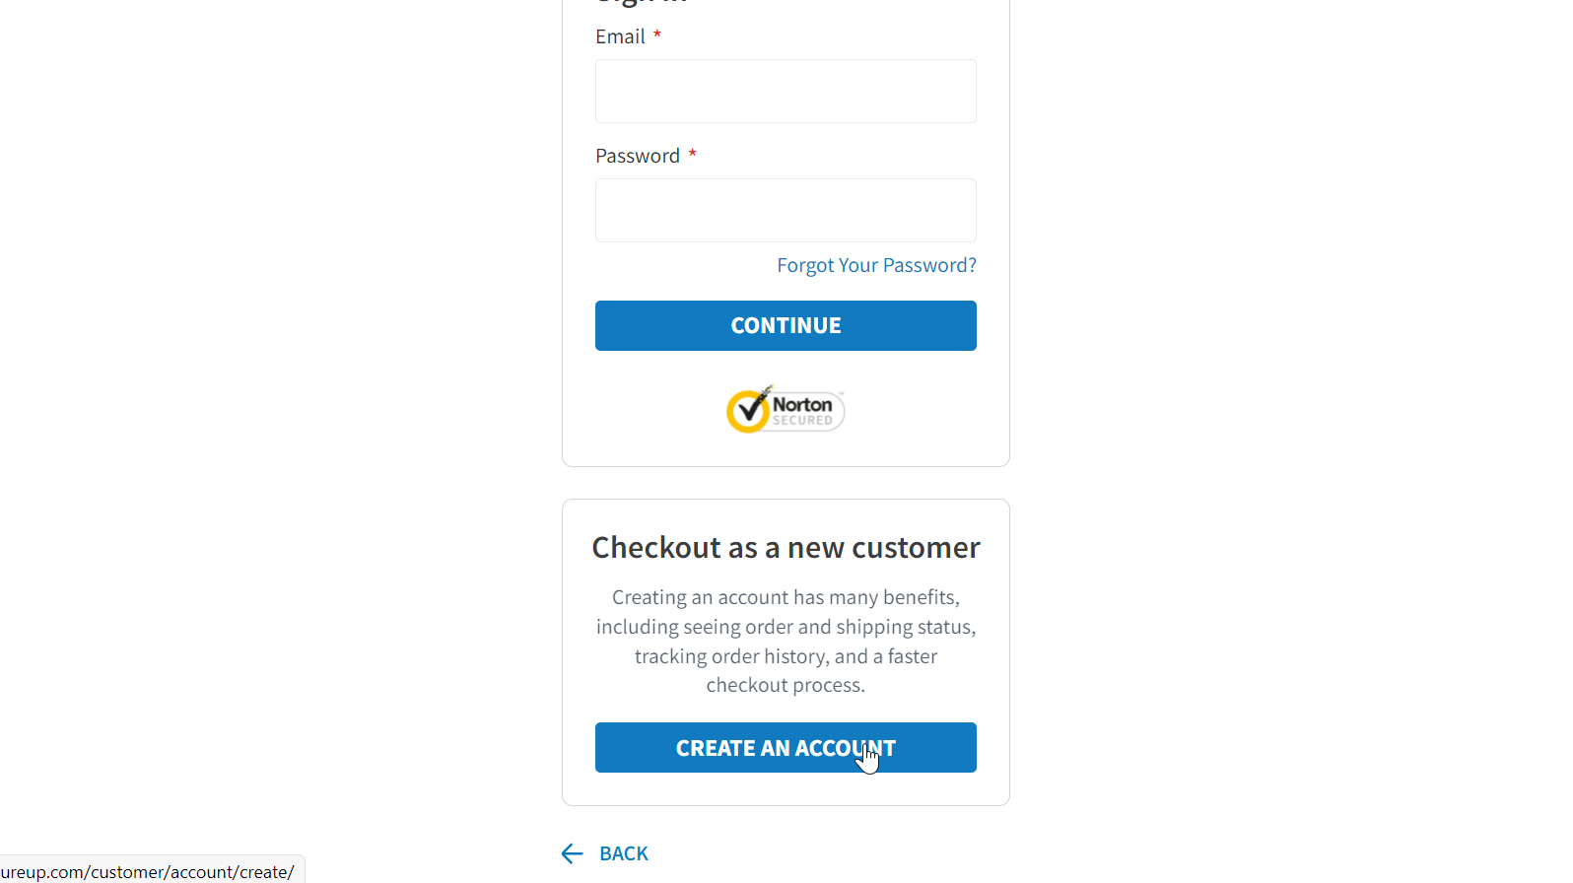
If you do not yet have an account with Measure Up, you can create one

Slide 26
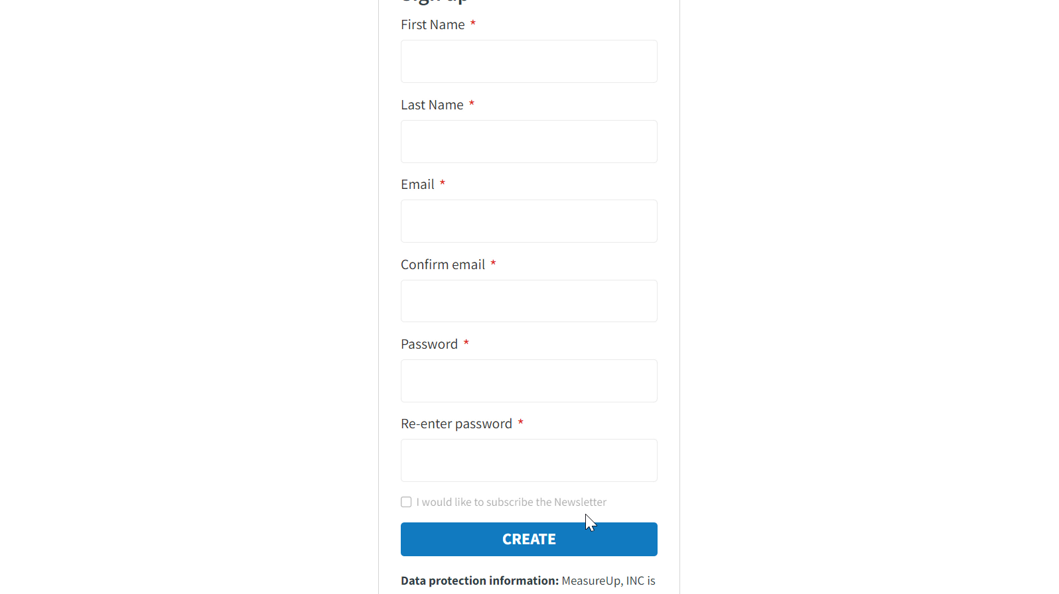

Slide 27
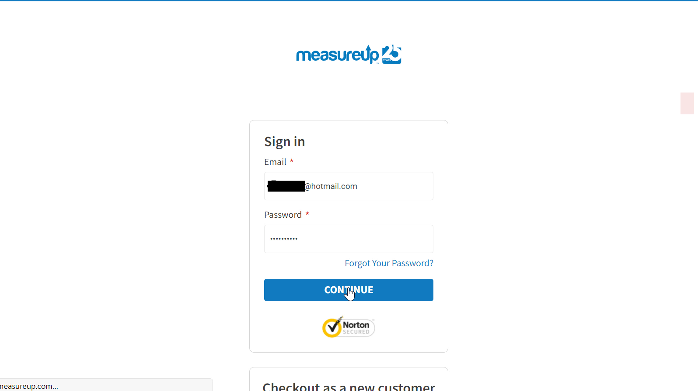

Slide 28
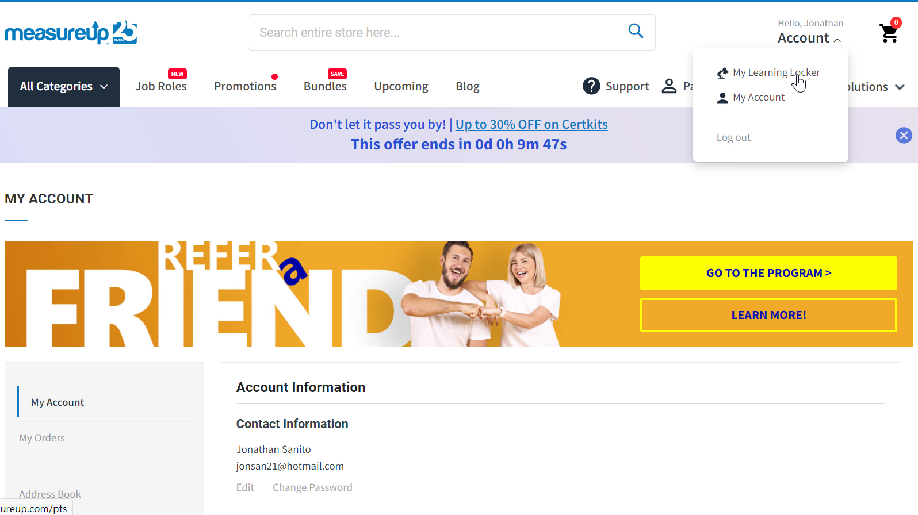
Once you are logged in, go to My Learning Locker

Slide 29
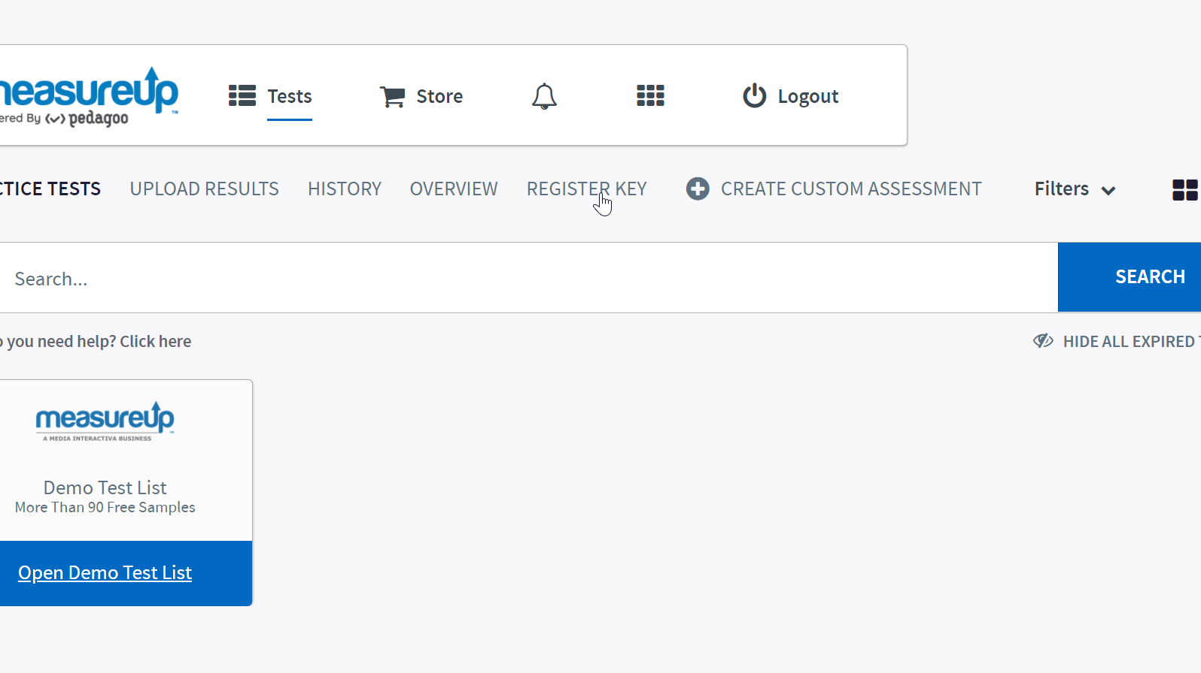
Then go to Register Key

Slide 30
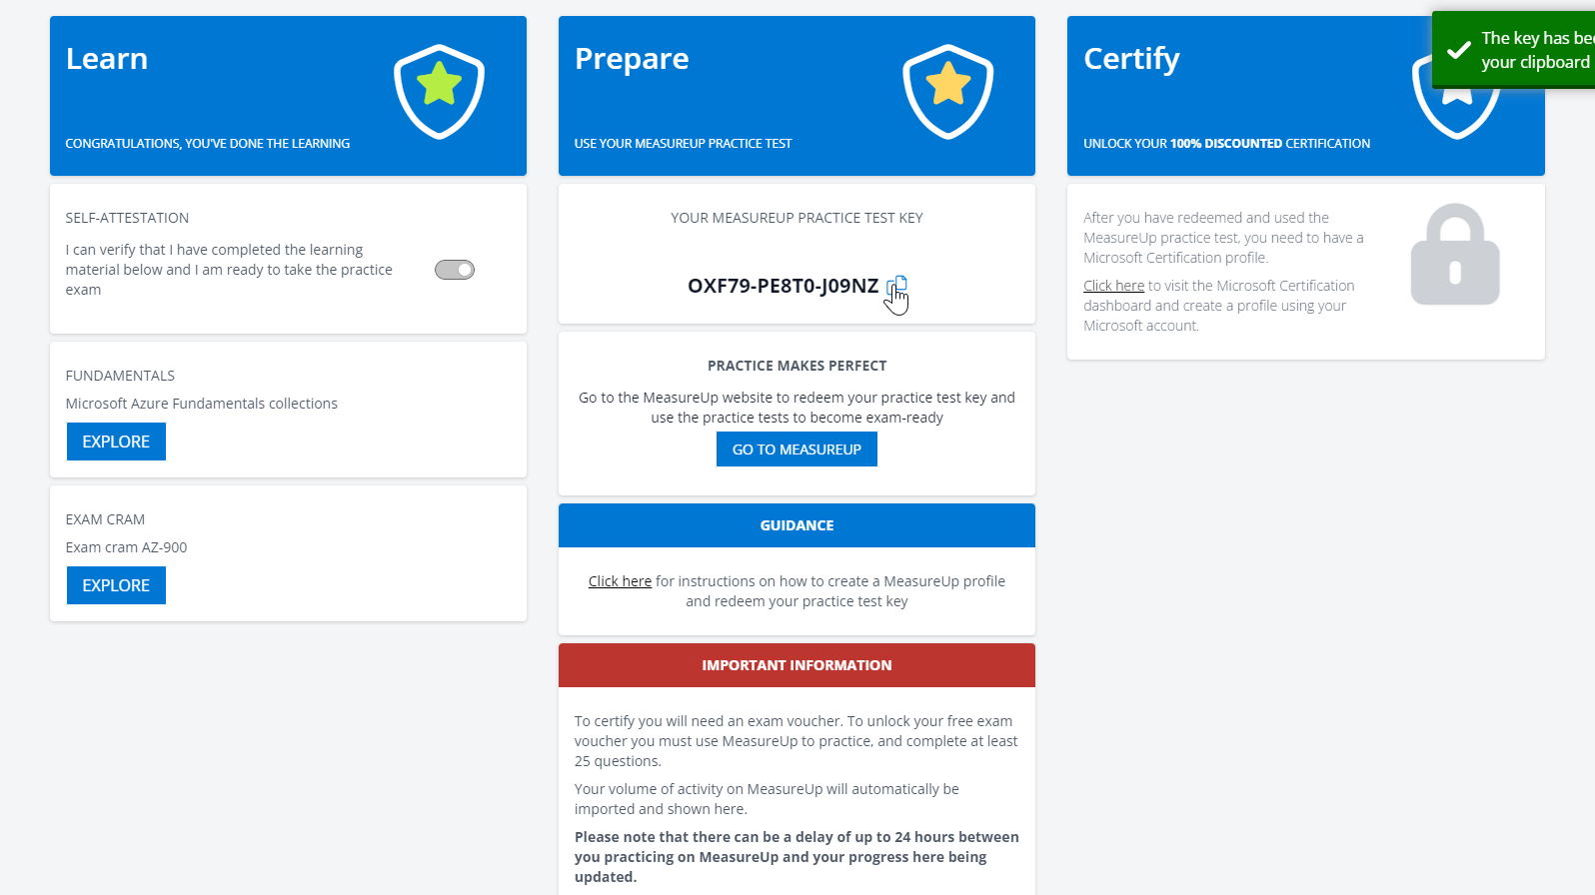
Copy the key that has been provisioned for you

Slide 31
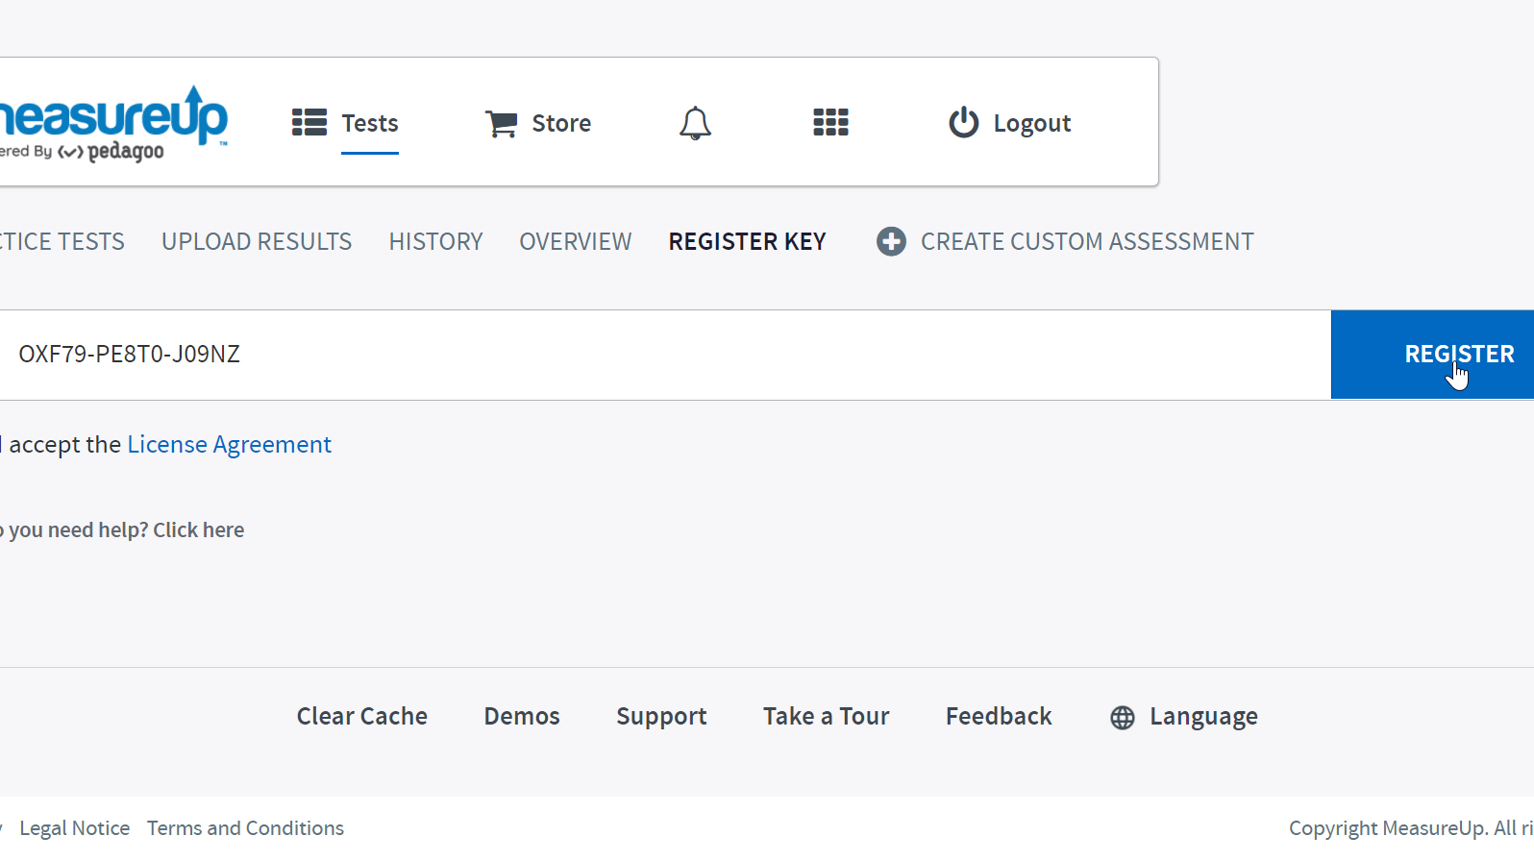
Paste it on Measure Up site, and Register to redeem the key. You can now practice for your Exam!

Slide 32
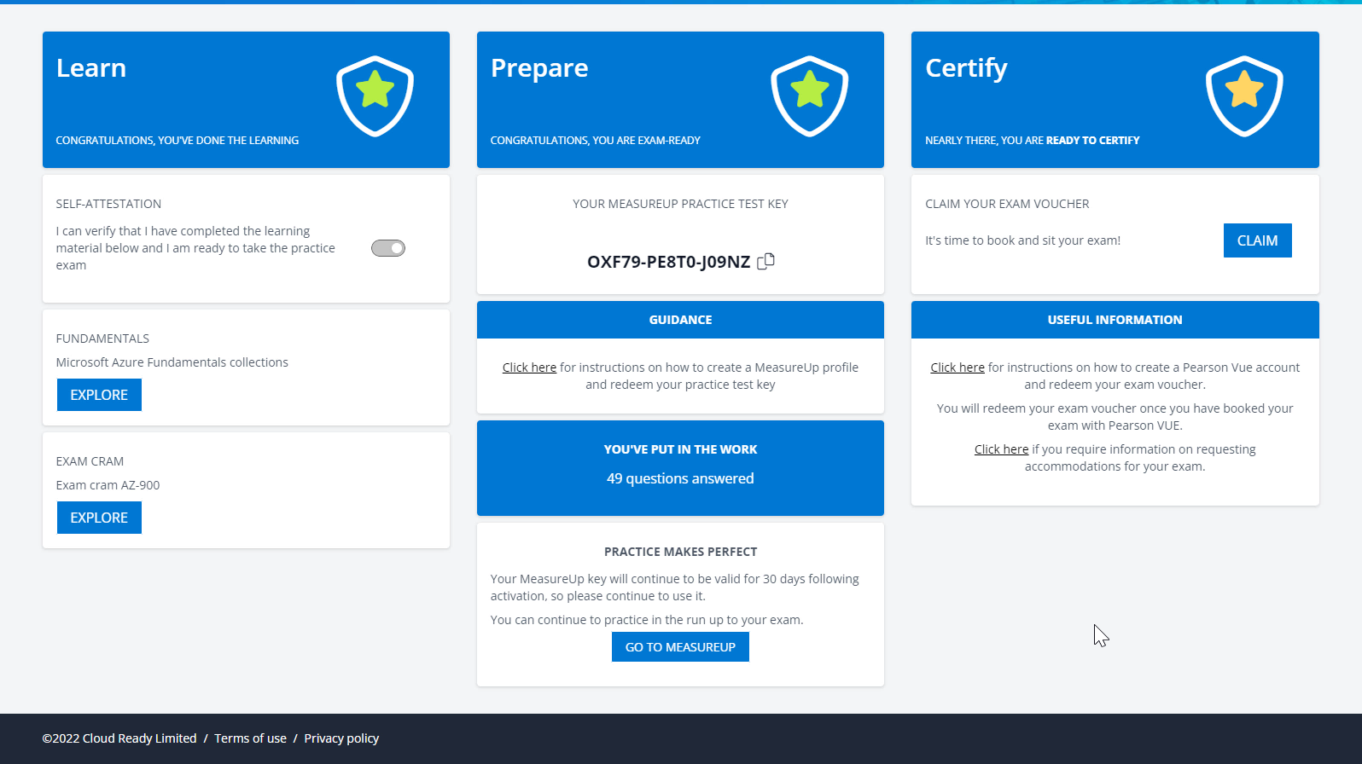
Once you practice, you will be eligible for an Exam Voucher (It might take 24 hours before your practice data is synced)

Slide 33
Now, claim your Free Exam Voucher!

Slide 34
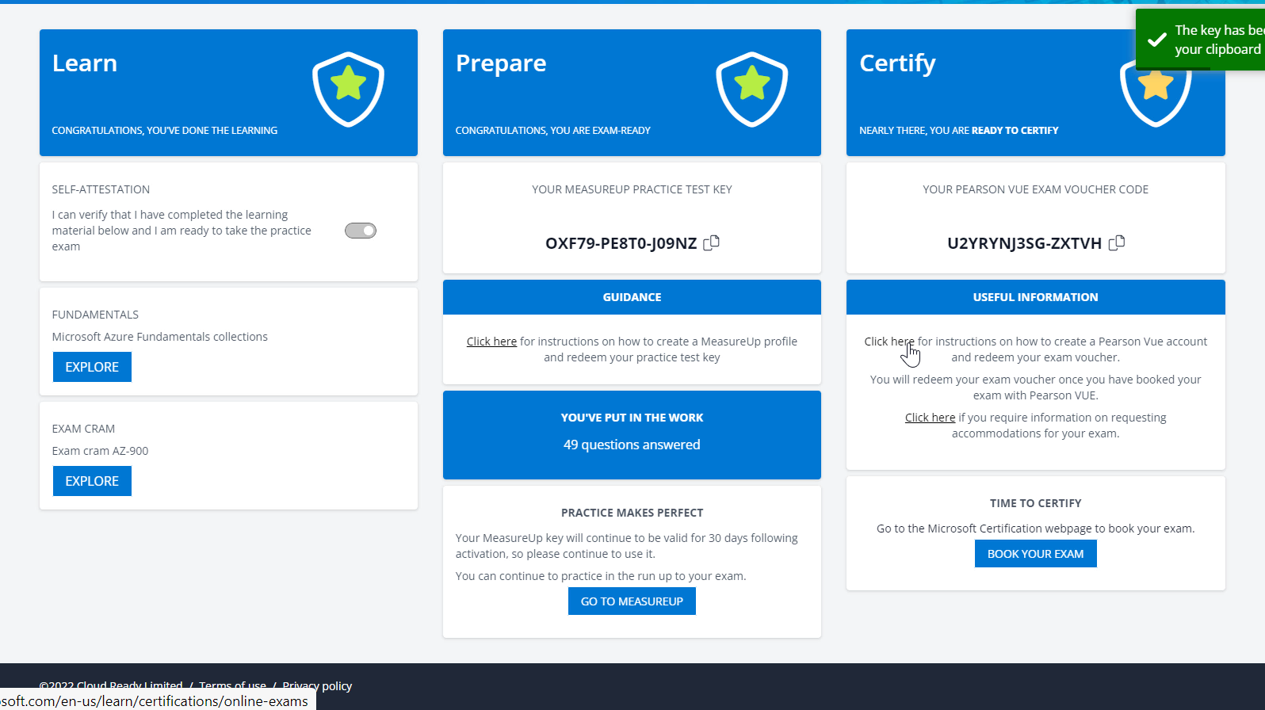
You can learn more about taking a Microsoft exam with Pearson Vue

Slide 35
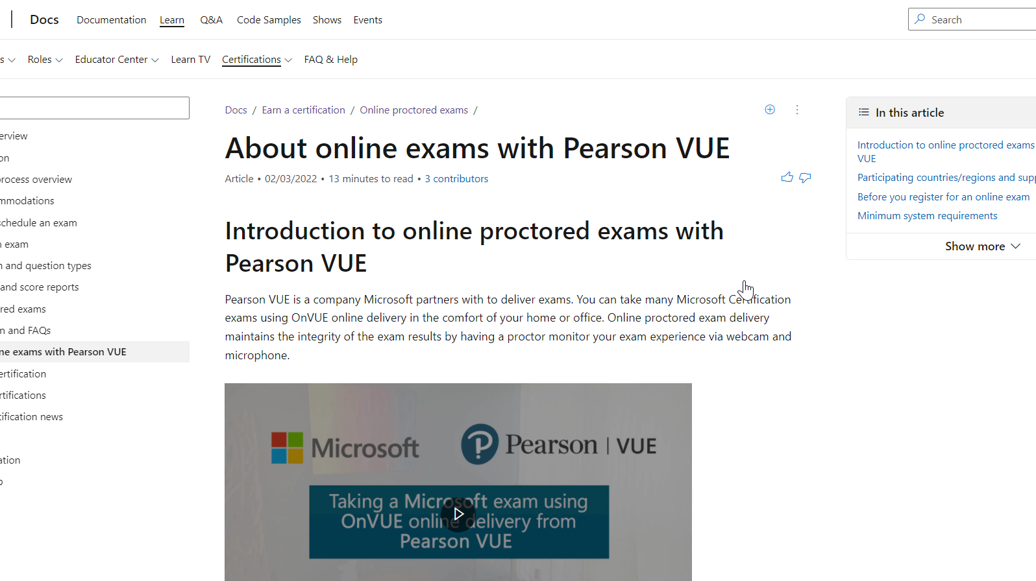
The exam will be delivered using Pearson Vue platform

Slide 36
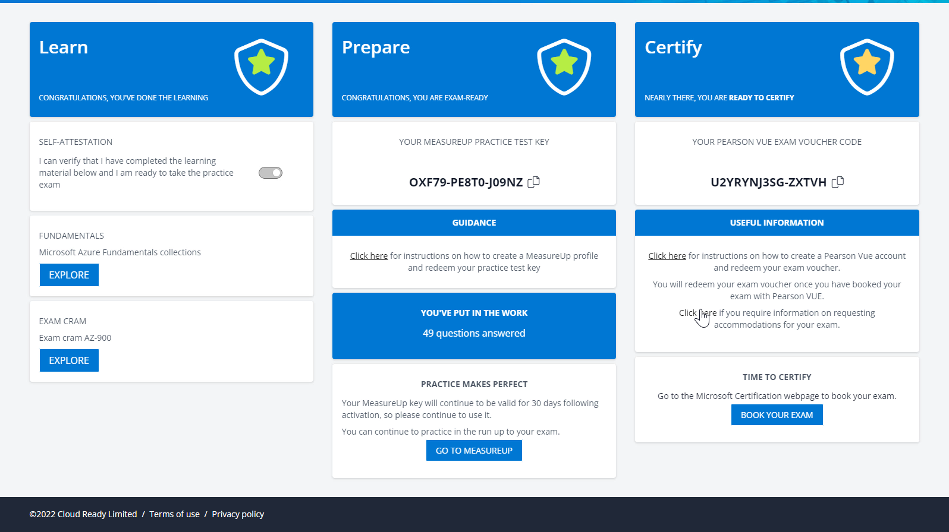
You can also learn about requesting accommodations

Slide 37
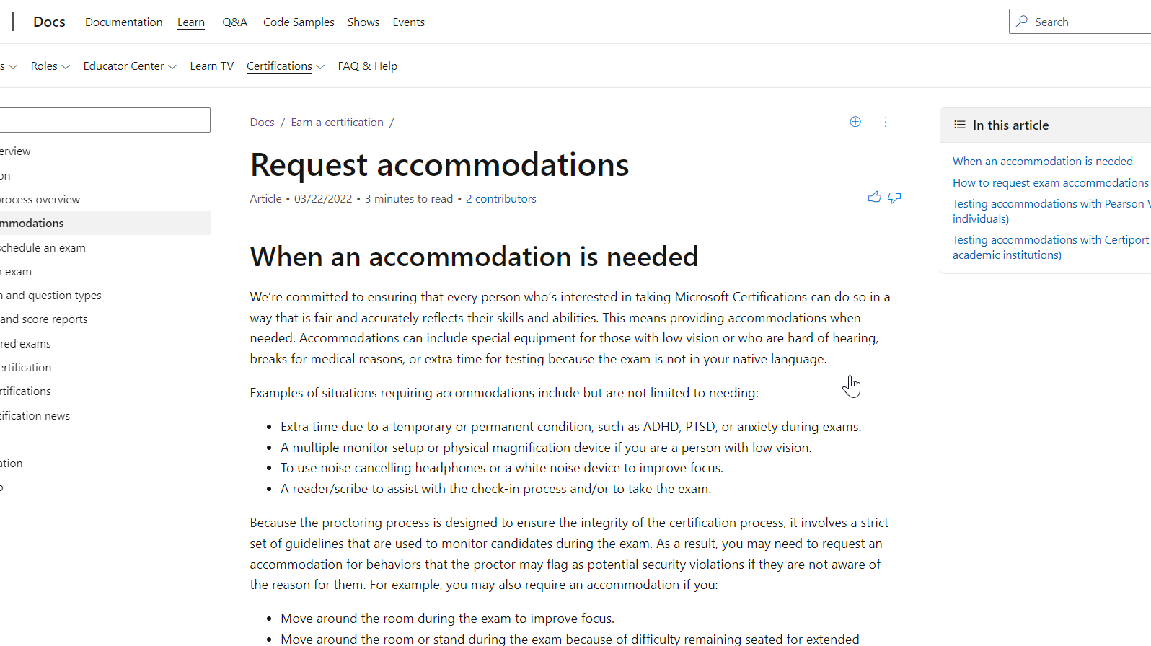
You can also learn about requesting accommodations

Slide 38
You’ve completed your learning. You’ve practiced for your exam. Now, go and book your exam!

Slide 39
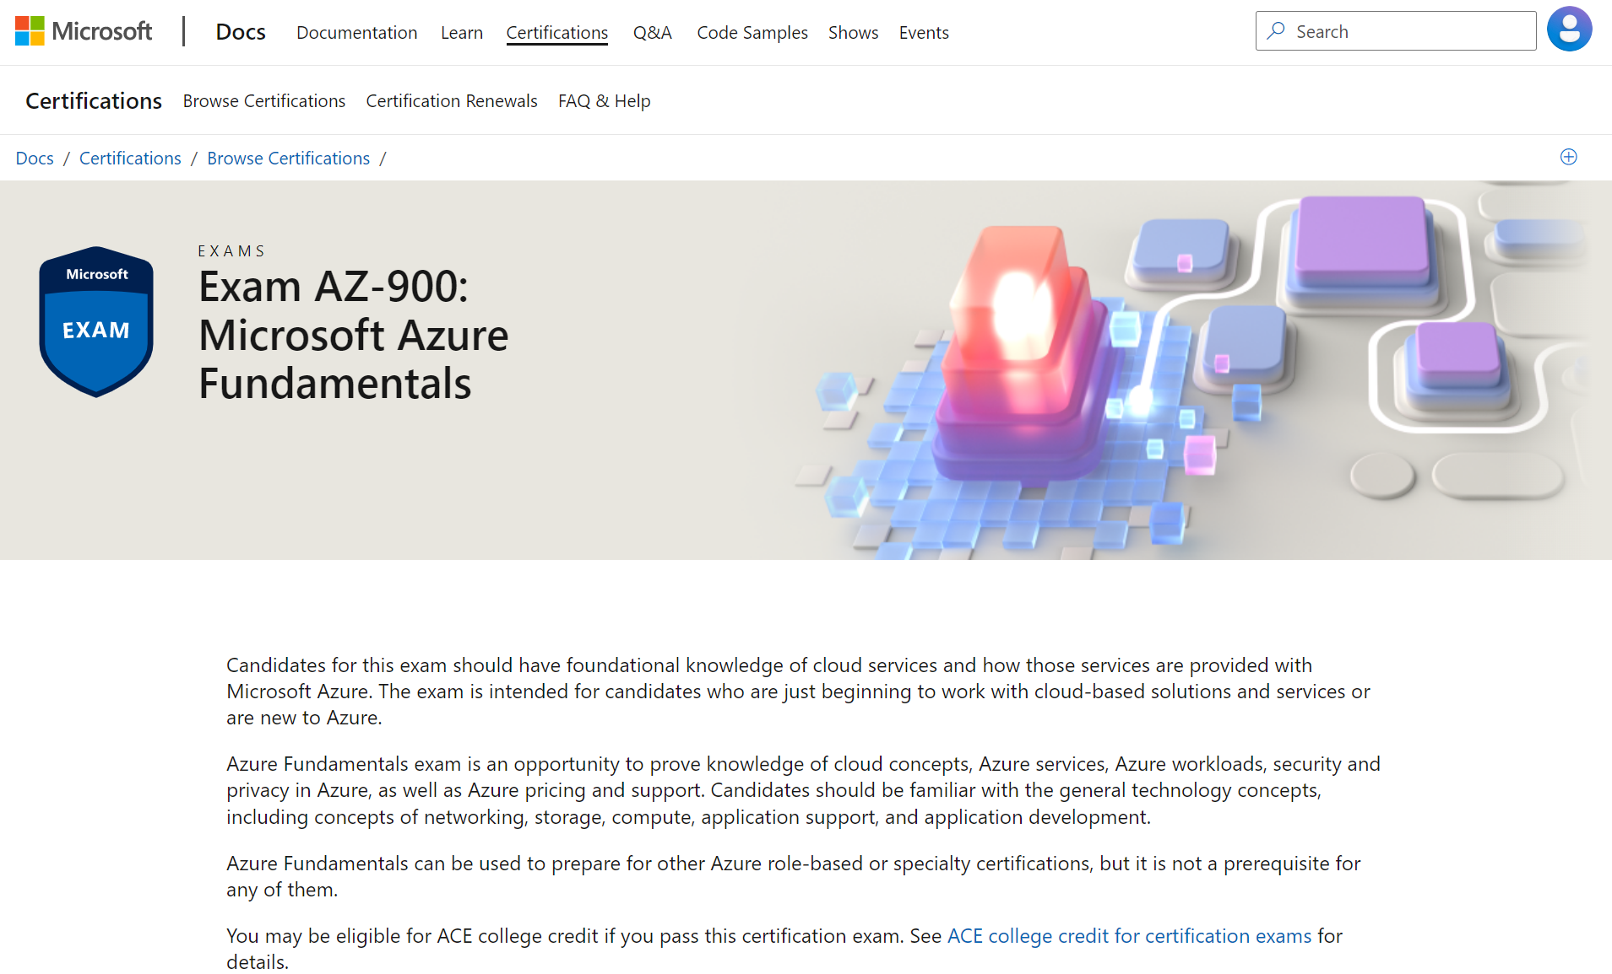
You will be taken to the Exam page

Slide 40
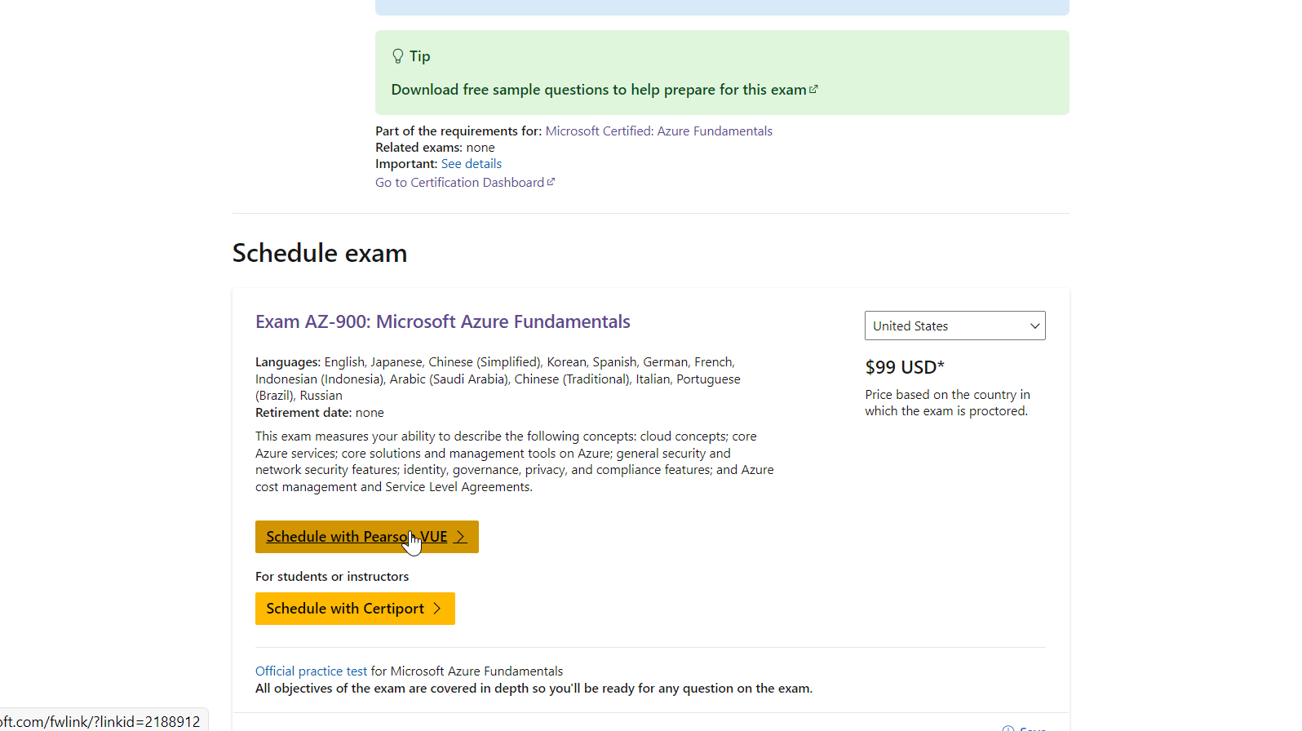
Scroll down and Schedule with Pearson Vue

Slide 41
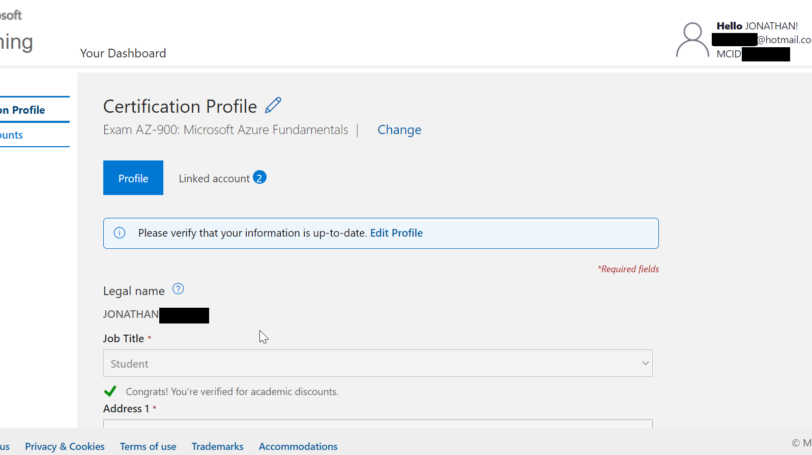
If prompted, sign in using your personal Microsoft account. If you have verified your academic status, you should see a green check mark when you select Student as Job Title

Slide 42
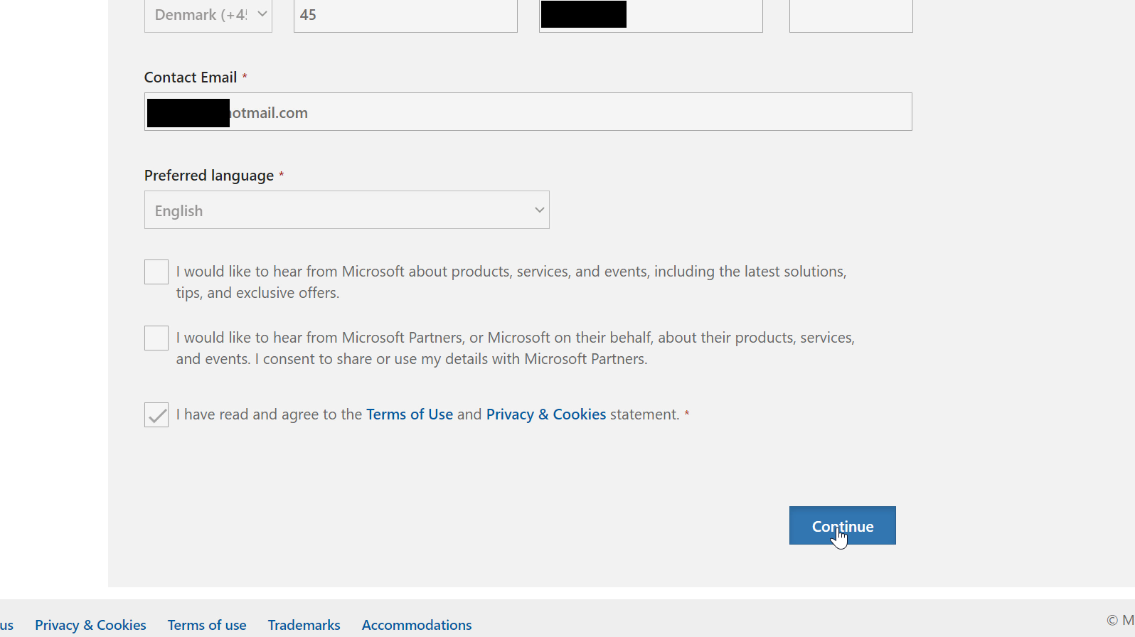
Click continue

Slide 43
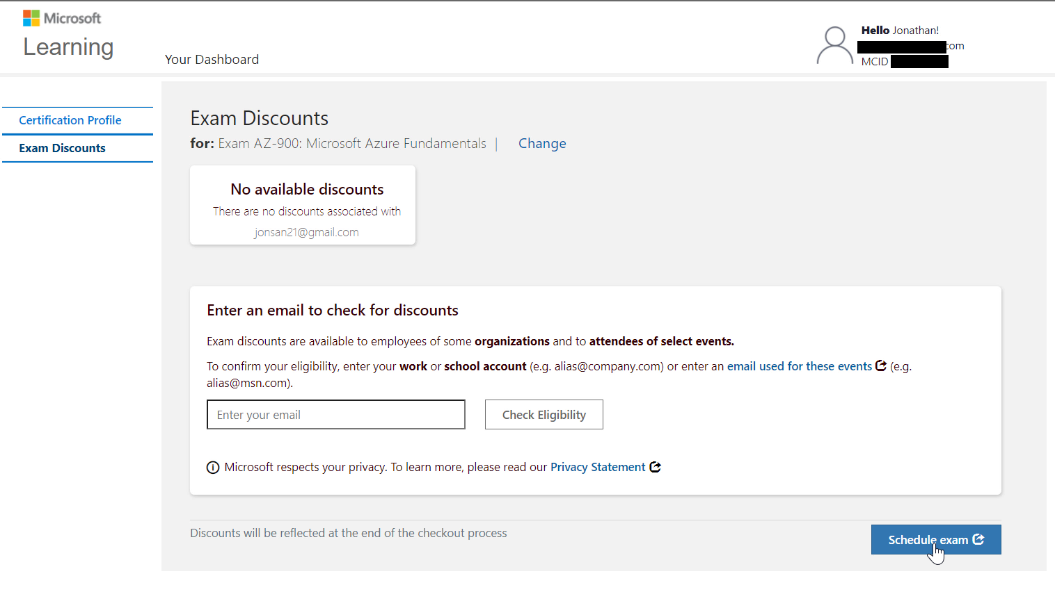
Click Schedule Exam

Slide 44
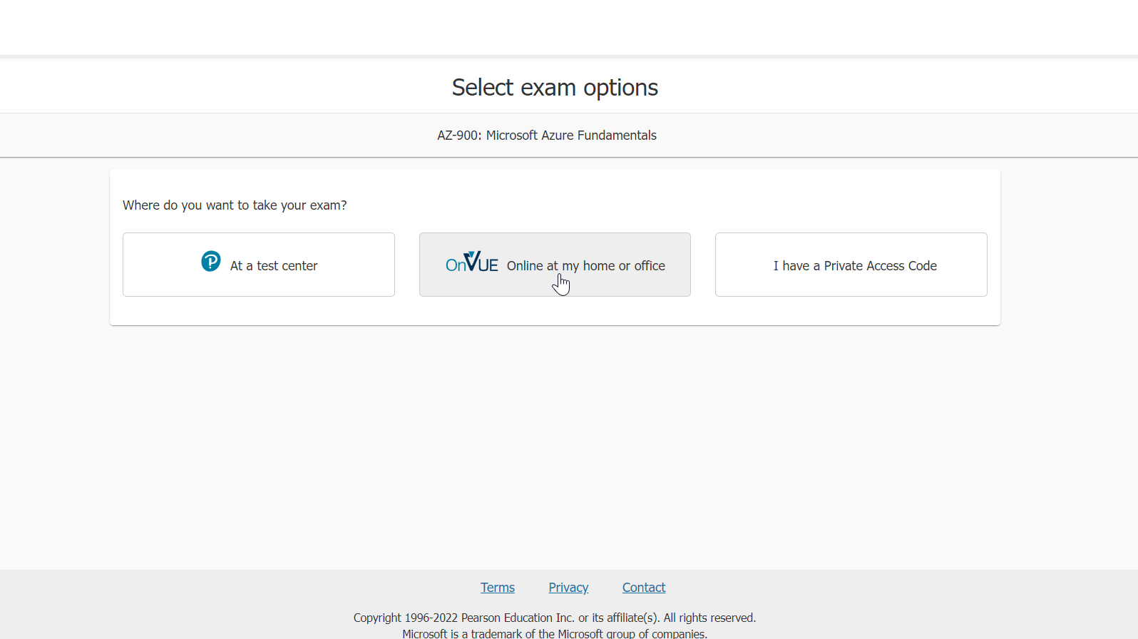
Follow the registration process

Slide 45
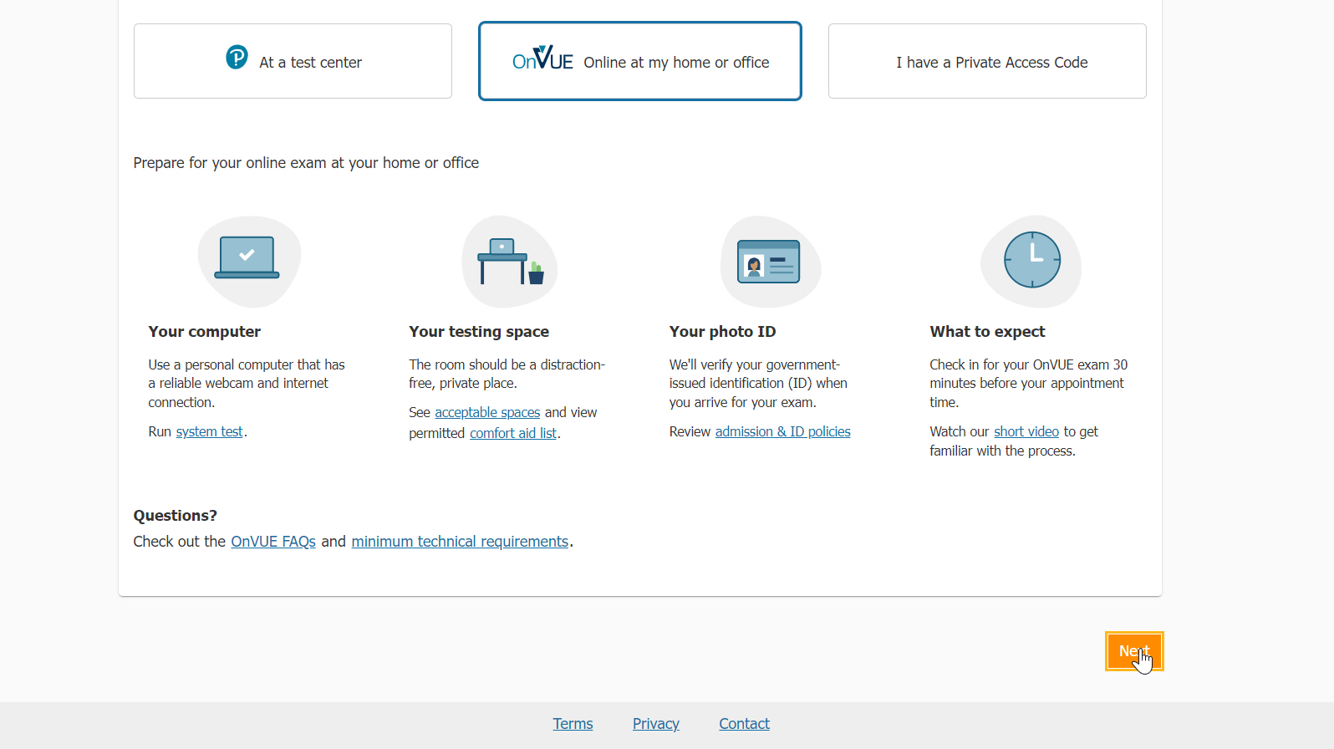

Slide 46
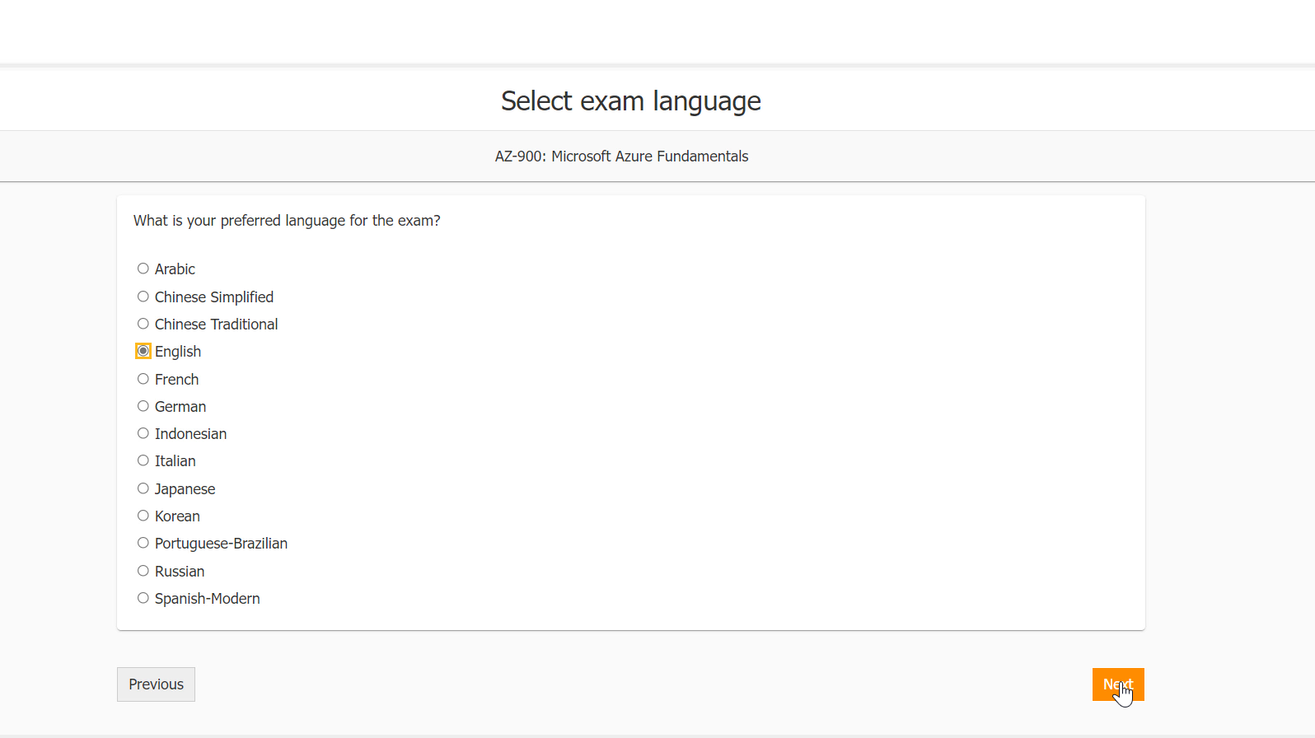

Slide 47
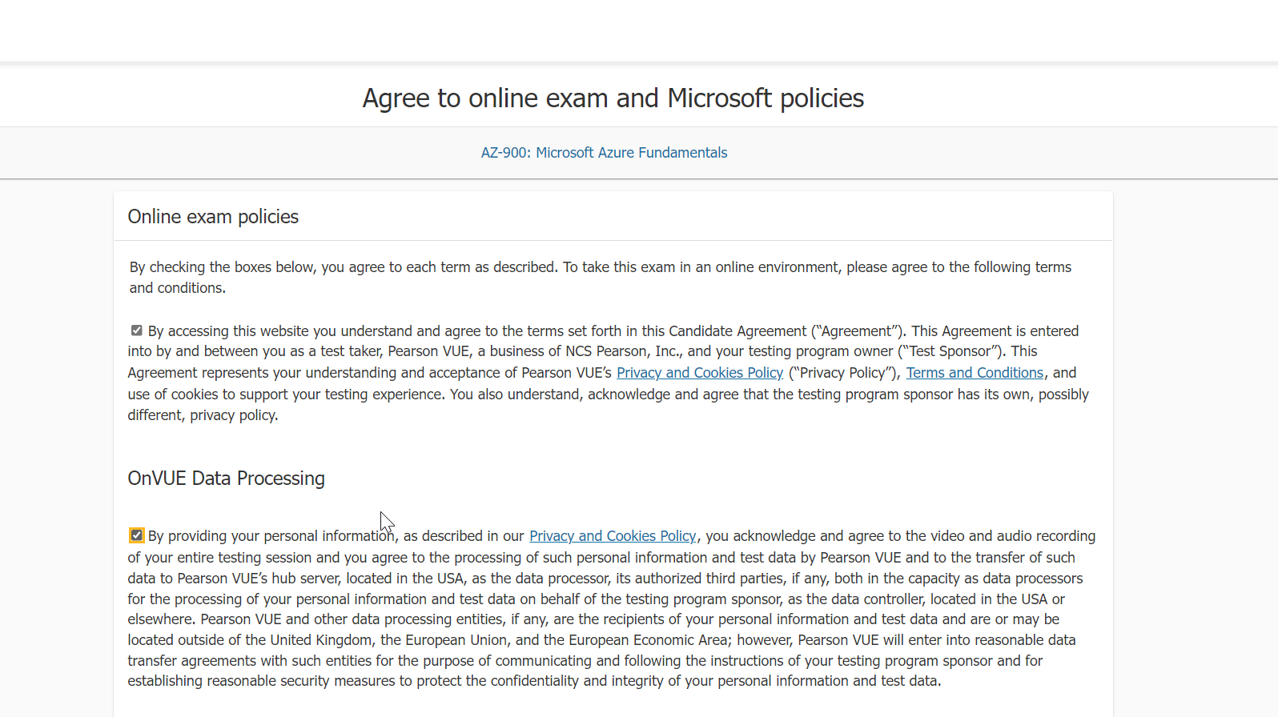

Slide 48
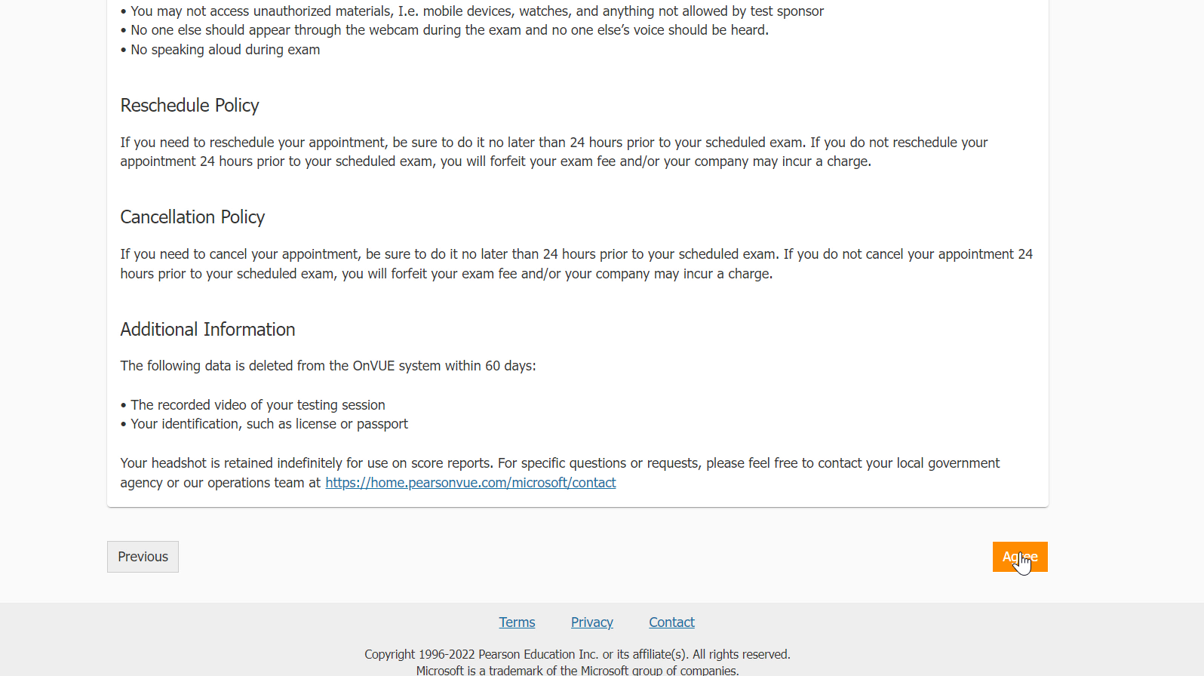

Slide 49
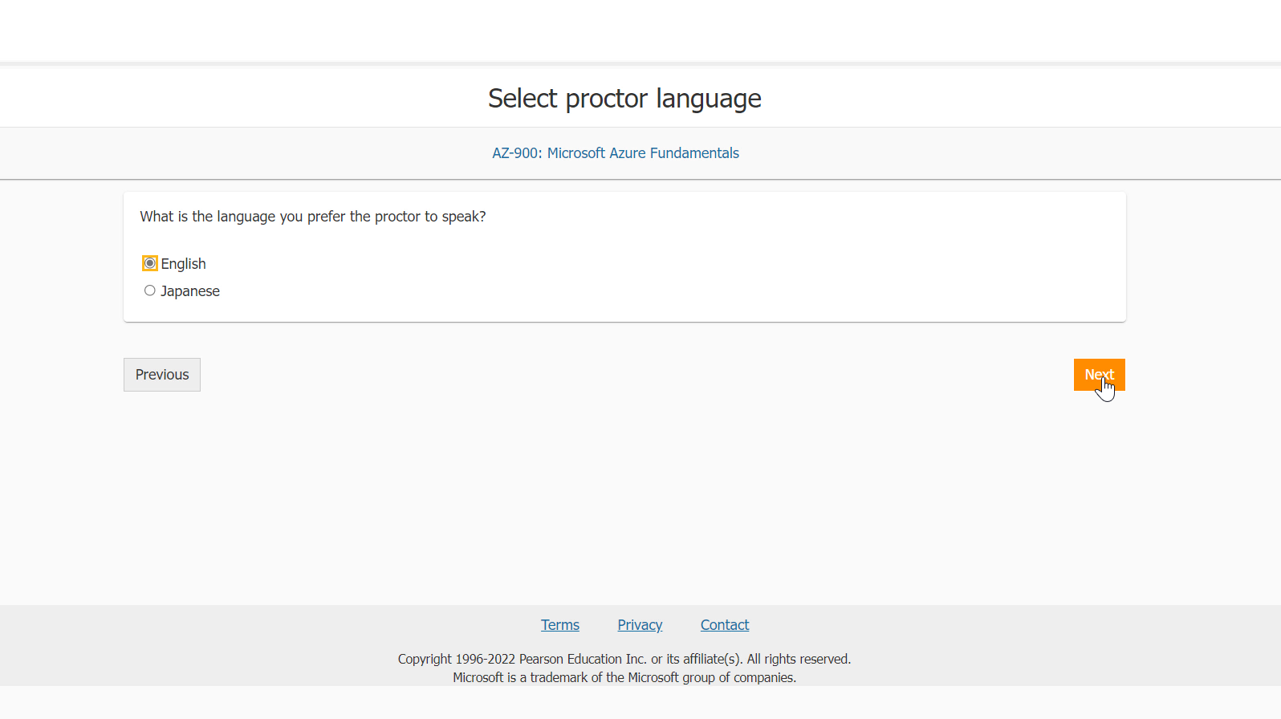

Slide 50
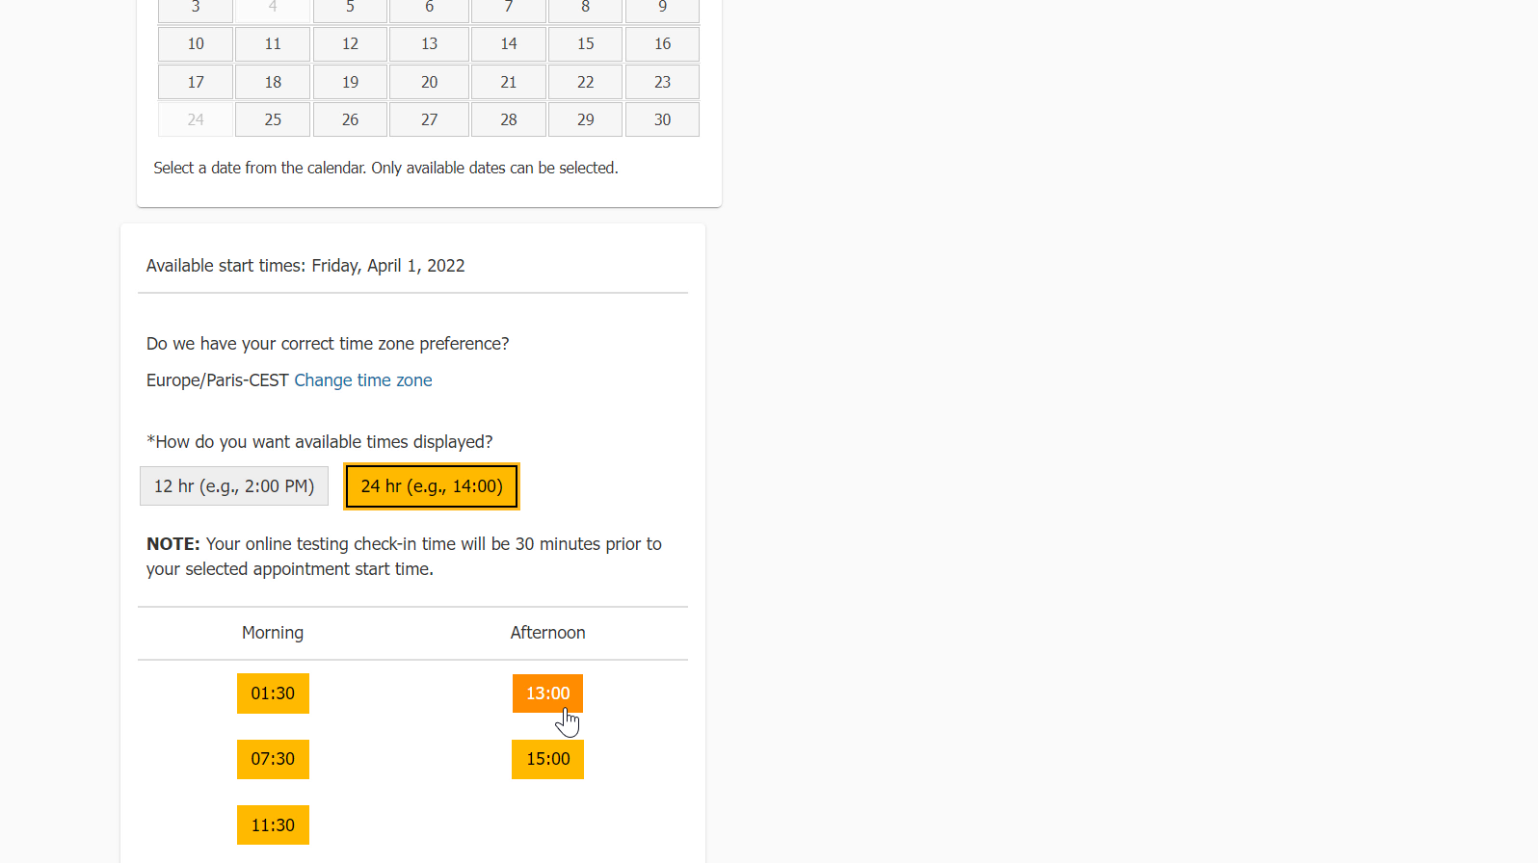

Slide 51
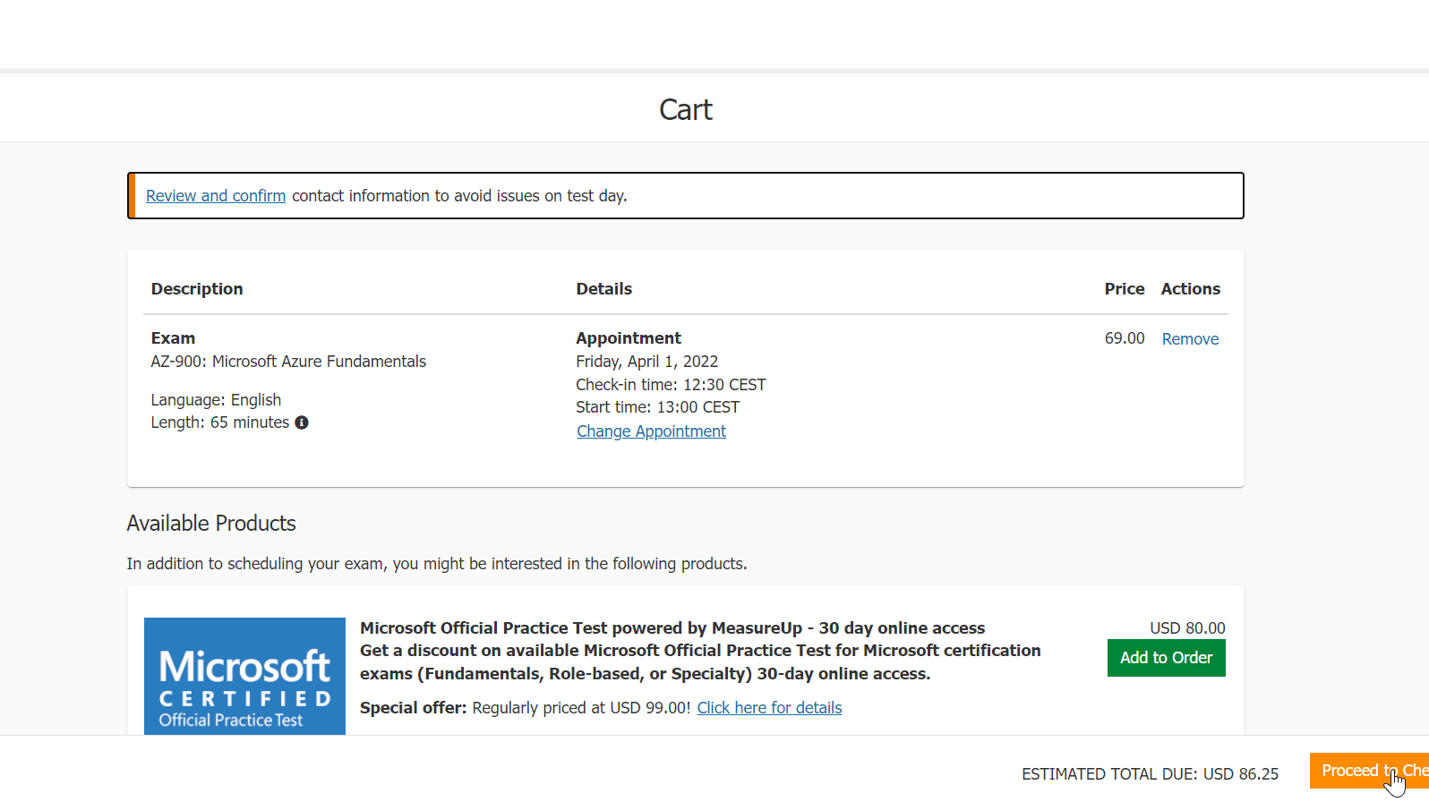
At this stage, you should see the price for the exam. You will need to redeem the exam voucher next.

Slide 52
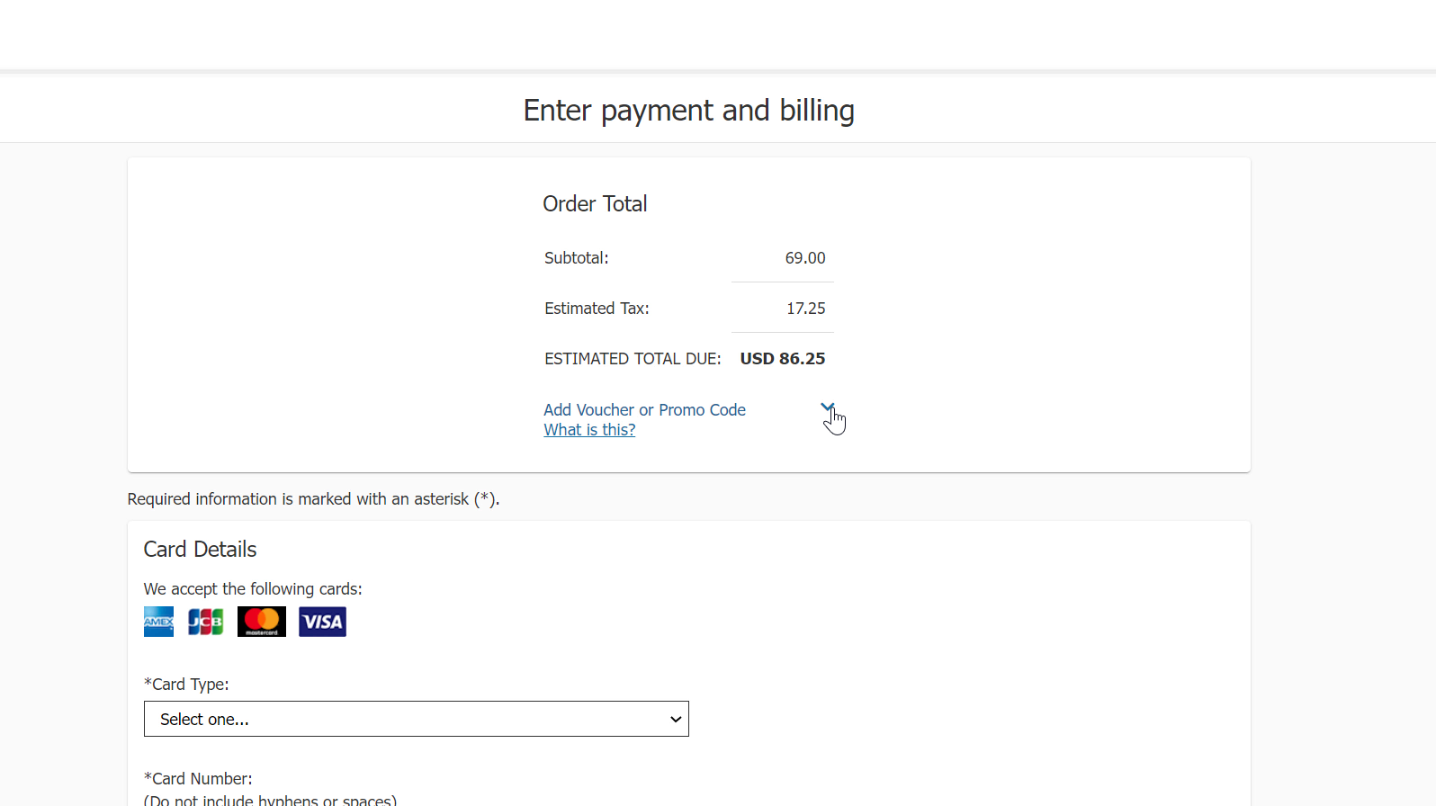
Add your voucher code

Slide 53
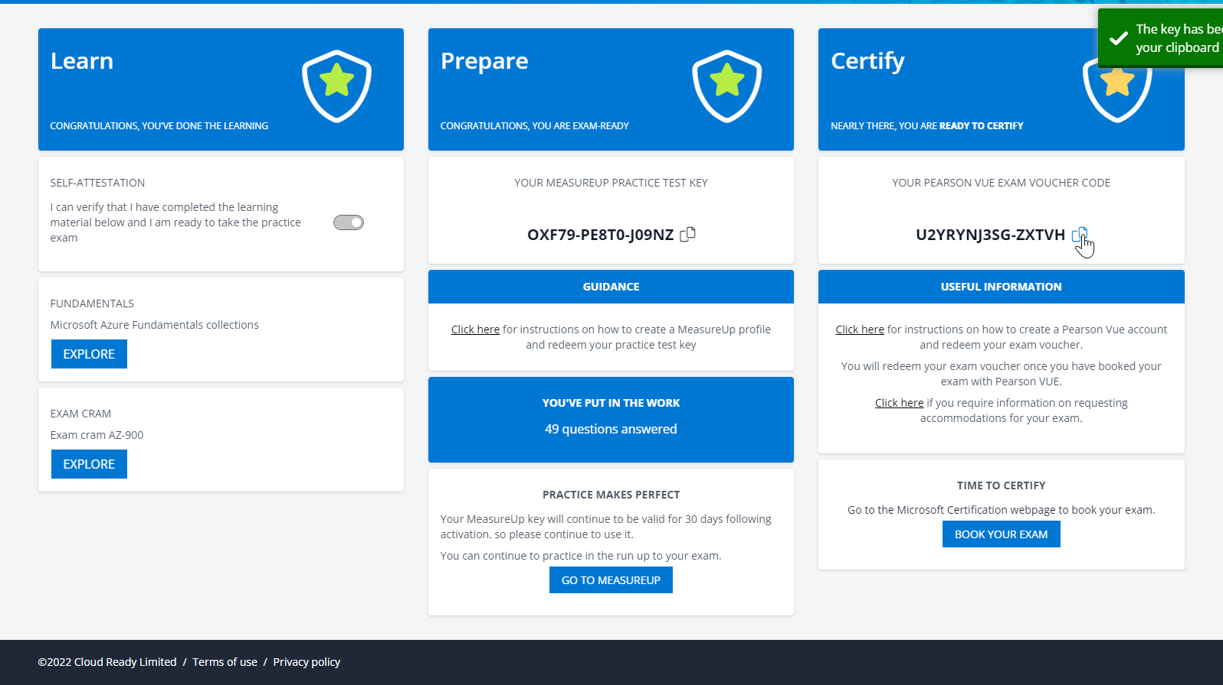
Copy the voucher code from the Cloud Ready site

Slide 54
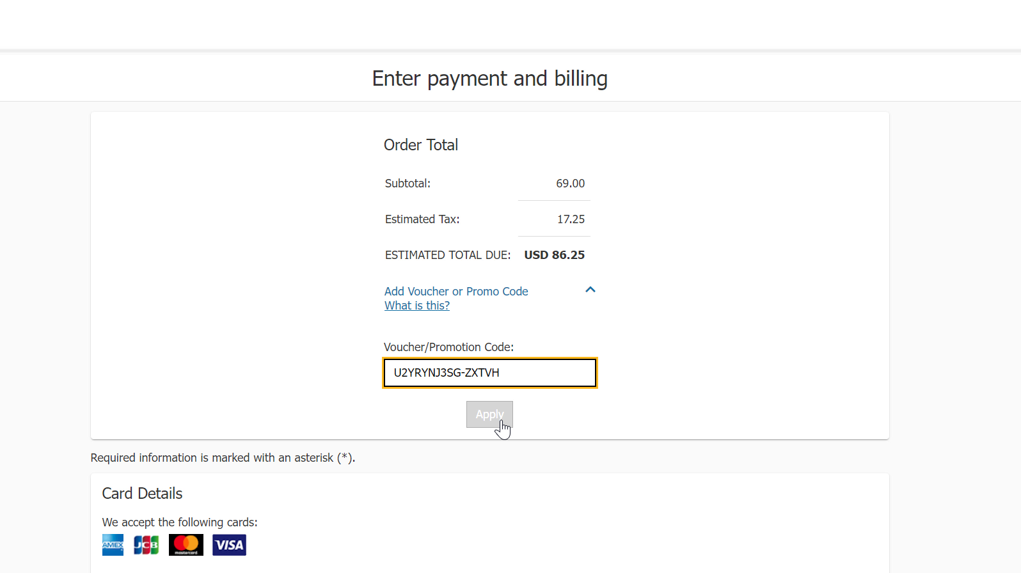
Paste it to the exam payment form

Slide 55
You should now see $0 for the Estimated Total Due

Slide 56
Good luck on your exam!!

Slide 57
When you go back to Cloud Ready, your exam status should be reflected (there might be 24 hour delay)

Slide 58
If you passed your exam, congrats! Now you can share your achievement.

Slide 59
Get your badge and share it out!

