Slide 1
Wordsee
An Innovative, new app for the hearing impaired
By Robert F. Lasko III
The Pitt Mobile App Challenge
“Show It” Category

Slide 2
Wordsee: an overview
Wordsee creates a small, floating dialogue box that would remain open over any other app and would translate all audio from the phone into words. The dialogue box can be customized based on font, font size, and color, and the box itself could be expanded or minimized by swiping it towards the center of the screen, or away from the center of the screen, respectively
Wordsee would help people with hearing impairment to stay more active socially, and it also has the potential to help students with hearing impairment to better understand video lectures
Wordsee’s key feature is its floating dialogue box that would utilize standard closed captioning capabilities
Wordsee would be intended for all devices that use the Android operating system

Slide 3
The target market for Wordsee would be the estimated 6.38 to 9.57 million US citizens with measurable hearing impairment
Wordsee is a one-of-a-kind app for the following reasons:
Few apps exist that translate phone calls alone, but Wordsee goes above and beyond to translate all audio on the phone
Dedicated closed caption phones do exist, but none of them are mobile
Deaf people rely almost solely on text messaging to communicate with others, so Wordsee will break down communication barriers
People with other levels of hearing impairment can also benefit from the visual dialogue and no longer have to second guess what they heard during their phone call
In addition to phone calls, this app would be able to translate any dialogue on the phone, including but not limited to Facebook videos (some of which lack closed captioning), YouTube videos, and online video lectures
Wordsee: Marketing Summary

Slide 4
Wordsee: technology summary
Wordsee will need to interface with a database that connects spoken words to the textual version of the word
Wordsee will use the internal audio of the phone to translate the dialogue into words. Essentially, the phone’s audio doesn’t have to be on, and there’s no dependence on the microphone. If sound is present on the screen, the app will detect it and interface with the database to translate it

Slide 5
Wordsee: Screen Mockups
Due to the simplicity of Wordsee’s design, we only need one screen for the app itself: the home screen
From the home screen, all settings for the app can be adjusted
This includes turning the app on/off, font style, font size, font color, and dialogue box color
The actual function of the app takes place outside of the app itself, on any other screen or app your phone has
The following slides contain visual representation of the app

Slide 6
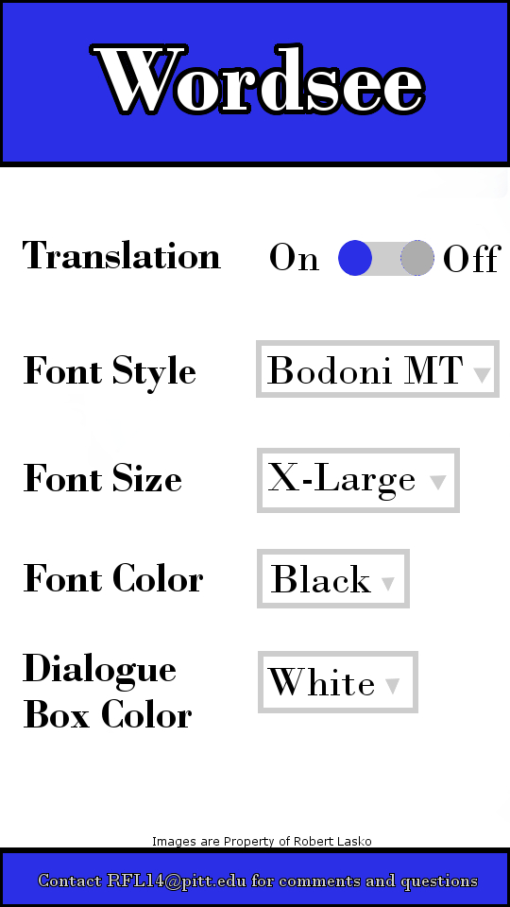
Wordsee: Home Screen
Home Screen/Main Screen
The home screen is where all of Wordsee’s features can be enabled, disabled, and adjusted
This is the central hub of the app, and the only screen the app itself will actually use when opened
Next to translation, the blue circle may be dragged to on/off to turn the dialogue box on/off
For the remaining options, selecting the gray outlined boxes brings dropdown menus with additional options to customize Wordsee to fit one’s needs
*Picture is to scale according to Android screen size

Slide 7
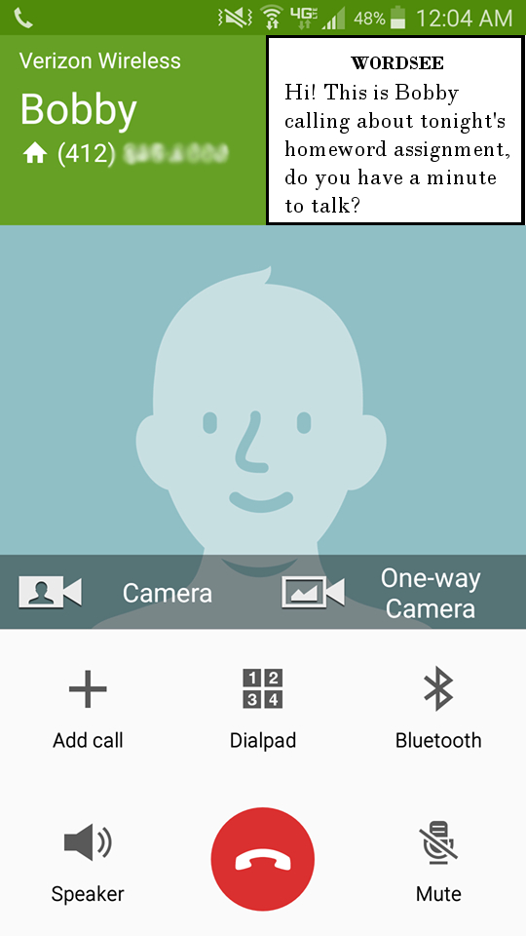
Wordsee: the floating dialogue box
App Feature 1: Floating Dialogue Box
Workflow Step A
The floating dialogue box will “float” over any other app you have open
This is where the primary function of Wordsee will take place
Once audio is translated in the database, the text is displayed in the floating dialogue box
As more text appears, the oldest line of text will scroll upwards and will be available to see again by scrolling down on the dialogue box
The text will move upwards as more audio is translated into text

Slide 8
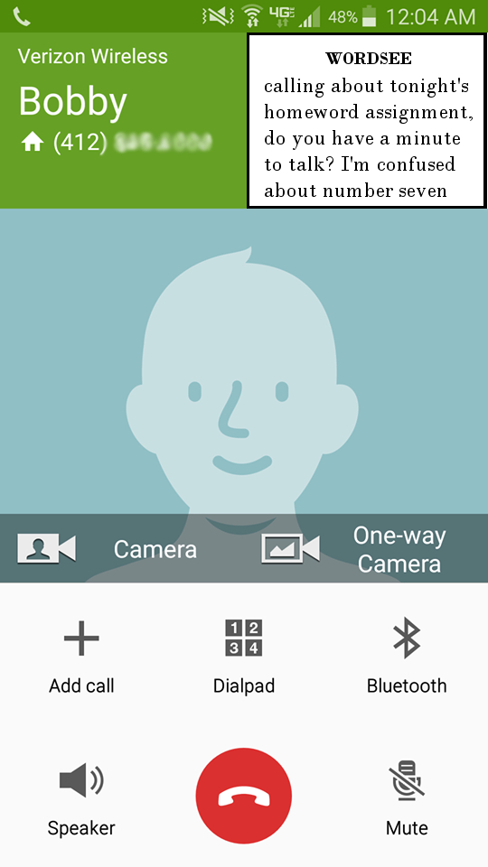
Wordsee: the floating dialogue box
App Feature 1: Floating Dialogue Box
Workflow Step B
As more text is translated, the old text goes upwards line after line
To read previous text, simply swipe downwards on the dialogue box
Swipe down to view older text translations

Slide 9
Wordsee: the floating dialogue box
App Feature 1: Floating Dialogue Box
Workflow Step C
After swiping down on the dialogue box, older parts of the conversation can now be seen
Wordsee will clear the text once it is minimized

Slide 10
Wordsee: adjusting the floating dialogue box
App Feature 2: Expand/Minimize Dialogue Box
Workflow Step A
Since the floating dialogue box may not always be in immediate use, it may be minimized and re-expanded
To minimize the dialogue box, swipe from the side of the box closest to the center of the screen to the other edge of the box
Swipe in the direction of the arrow to minimize the dialogue box

Slide 11
Wordsee: adjusting the floating dialogue box
App Feature 2: Expand/Minimize Dialogue Box
Workflow Step B
The dialogue box has now been minimized, and as a result of this, all previously translated text has been cleared from the dialogue box
To re-expand the dialogue box, simply tap the circle with the “W” inside of it once
Tap the “W” to re-expand the dialogue box

Slide 12
Wordsee: adjusting the floating dialogue box
App Feature 2: Expand/Minimize Dialogue Box
Workflow Step C
The dialogue box has now been re-expanded
Since the dialogue box was minimized, all of the text that was previously in the dialogue box has been cleared, creating a fresh start for more text

Slide 13
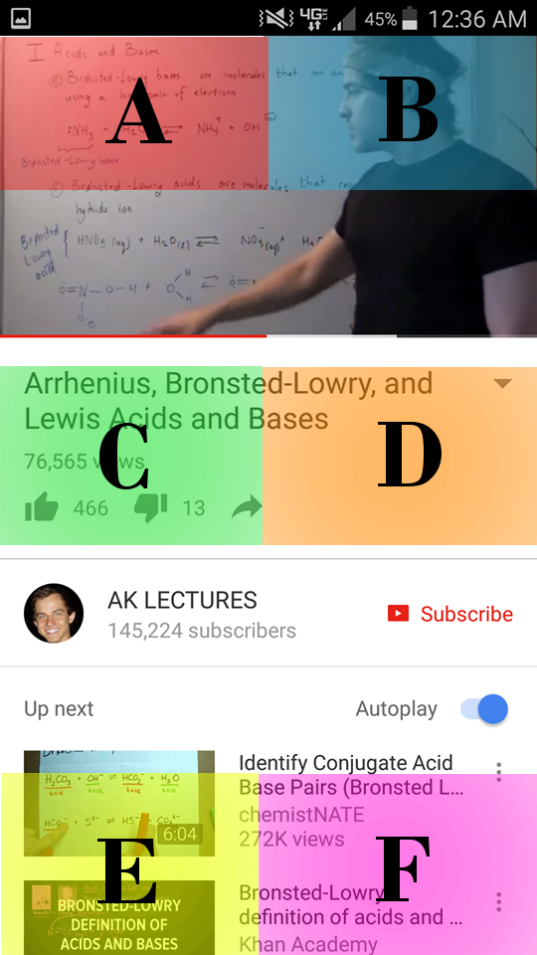
Wordsee: Moving the floating dialogue box
App Feature 3: Moving the Dialogue Box
Workflow Step A
Since certain parts of the screen may become more or less important throughout the day (such as when the focus of a video shifts), the floating dialogue box can be moved
The floating dialogue box can be moved to one of the six sections seen in the image

Slide 14
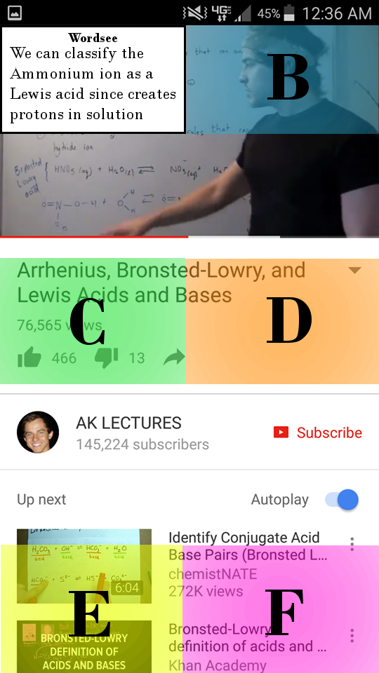
Wordsee: Moving the floating dialogue box
App Feature 3: Moving the Dialogue Box
Workflow Step B
To move the dialogue box from its current position (Section A) to another position, such as Section D, drag from the center of the dialogue box to the desired position
Drag from the center of the dialogue box to the desired position to move it

Slide 15
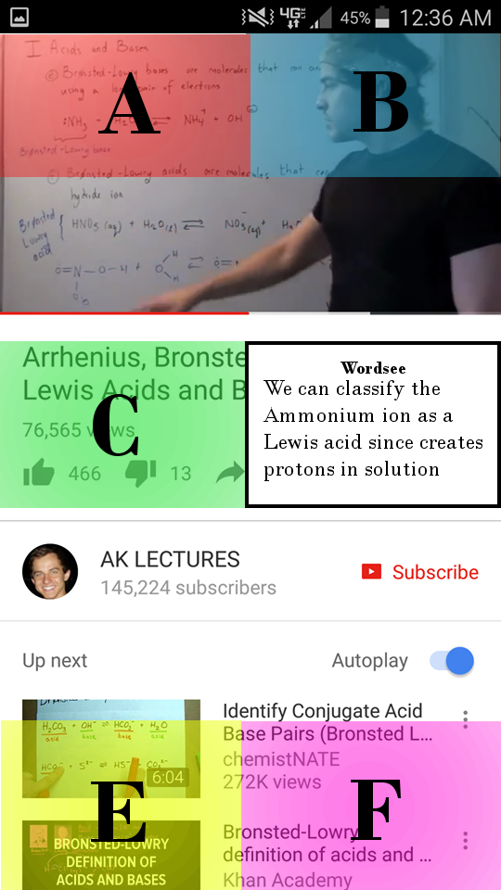
Wordsee: Moving the floating dialogue box
App Feature 3: Moving the Dialogue Box
Workflow Step C
The dialogue box has now been moved to Section D and is no longer obstructing one’s view of the video
The mobility of the floating dialogue box is crucial to its effectiveness, since a dialogue box that is fixed in one position may prevent one from viewing important information on the screen

Slide 16
Wordsee: Moving the floating dialogue box
App Feature 3: Moving the Dialogue Box
Workflow Step D
The dialogue box can also be moved when it is minimized. To do this, hold and drag the circle with the “W” on it to the desired section of the screen
For example, to move the minimized dialogue box from Section A to Section D, hold and drag the circle to the desired section
Drag the circle with the “W” in it to the desired location to move it

Slide 17
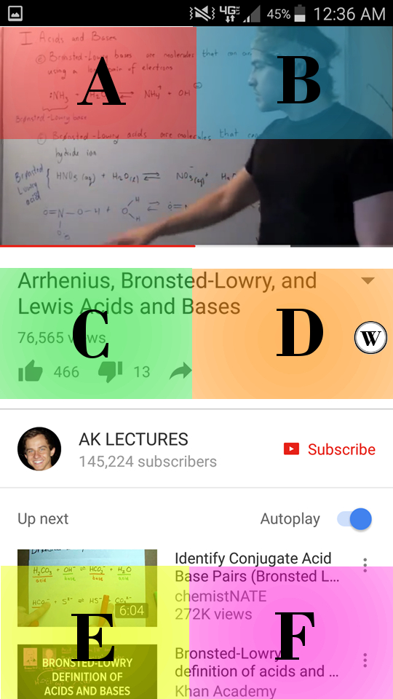
Wordsee: Moving the floating dialogue box
App Feature 3: Moving the Dialogue Box
Workflow Step E
The minimized dialogue box has now been moved to Section D
The dialogue box can now be re-expanded to display more translations by tapping the circle once
Tap the circle with the “W” in it to re-expand the dialogue box

Slide 18
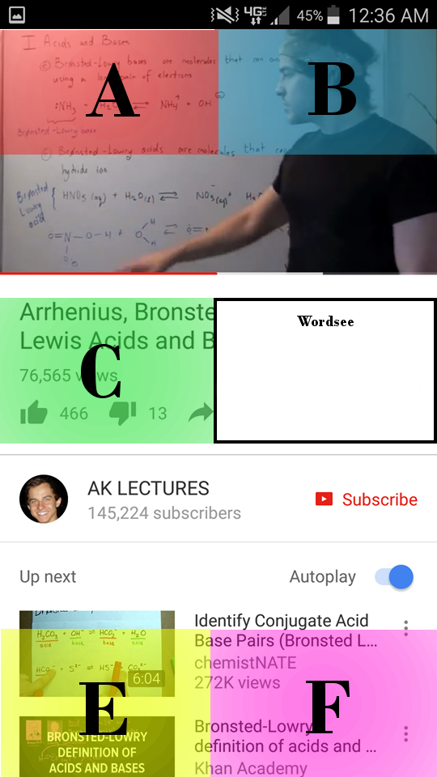
Wordsee: Moving the floating dialogue box
App Feature 3: Moving the Dialogue Box
Workflow Step F
The dialogue box has now been re-expanded in its new location
Since the dialogue box was minimized, all previous text displayed in the box has been cleared
The dialogue box has been re-expanded in its new location

Slide 19
As evidenced previously, Wordsee is an innovative, yet simple app that can potentially improve the lives of millions of people with some level of hearing impairment
The simplicity of Wordsee would make it easy to navigate for everyone, regardless of familiarity with technology
The novel nature of Wordsee meets the needs of many to the fullest capacity. Other apps that are similar to Wordsee aren’t nearly as effective and are neither as user-friendly nor as simple in design as Wordsee
The simplicity of Wordsee and the limited use of phone features also places little strain on the phone itself and its battery
Wordsee: the conclusion

Slide 20
References for statistics throughout the presentation, particularly in the Marketing Summary:
https://ifmyhandscouldspeak.wordpress.com/common-myths-about-deaf-people-and-the-truth/
https://www.nidcd.nih.gov/health/statistics/quick-statistics-hearing
Wordsee: references

